Slide 1
Medieval Manuscripts

Slide 2
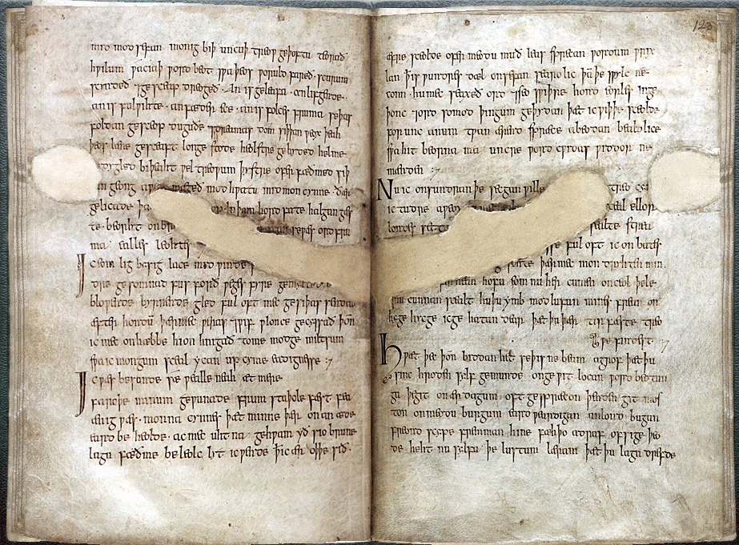
The Exeter Book Riddles
Old English poetry (10th c. manuscript): Cathedral Library, Exeter MS. 3501.

Slide 3
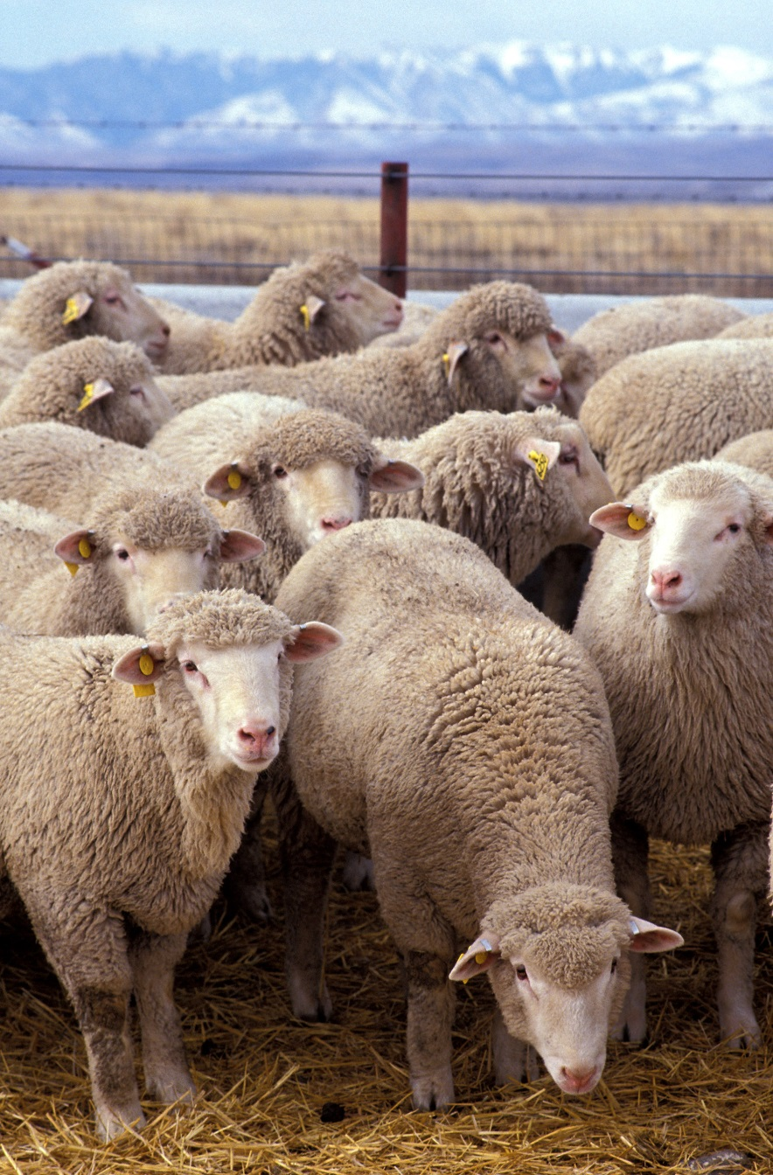
Making Parchment
Parchment = stretched and processed animal skin (goat, sheep, calf, cow)
(but see also: anthropodermic bibliopegy)
Domestic sheep. Public Domain, https://commons.wikimedia.org/w/index.php?curid=16818.
Notes:
87

Slide 4
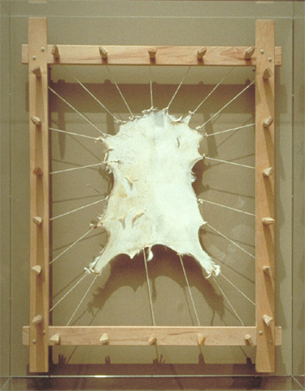
Making Parchment
Skin is soaked in lime solution to loosen animal hair
Animal hair removed with curved knife
Skin wetted and stretched on special rack
Pictured: Skin of a stillborn goat on a stretcher. Modern parchment making. J. Paul Getty Museum (https://www.getty.edu/art/exhibitions/making/zoom_parchment.html)
Notes:
87

Slide 5
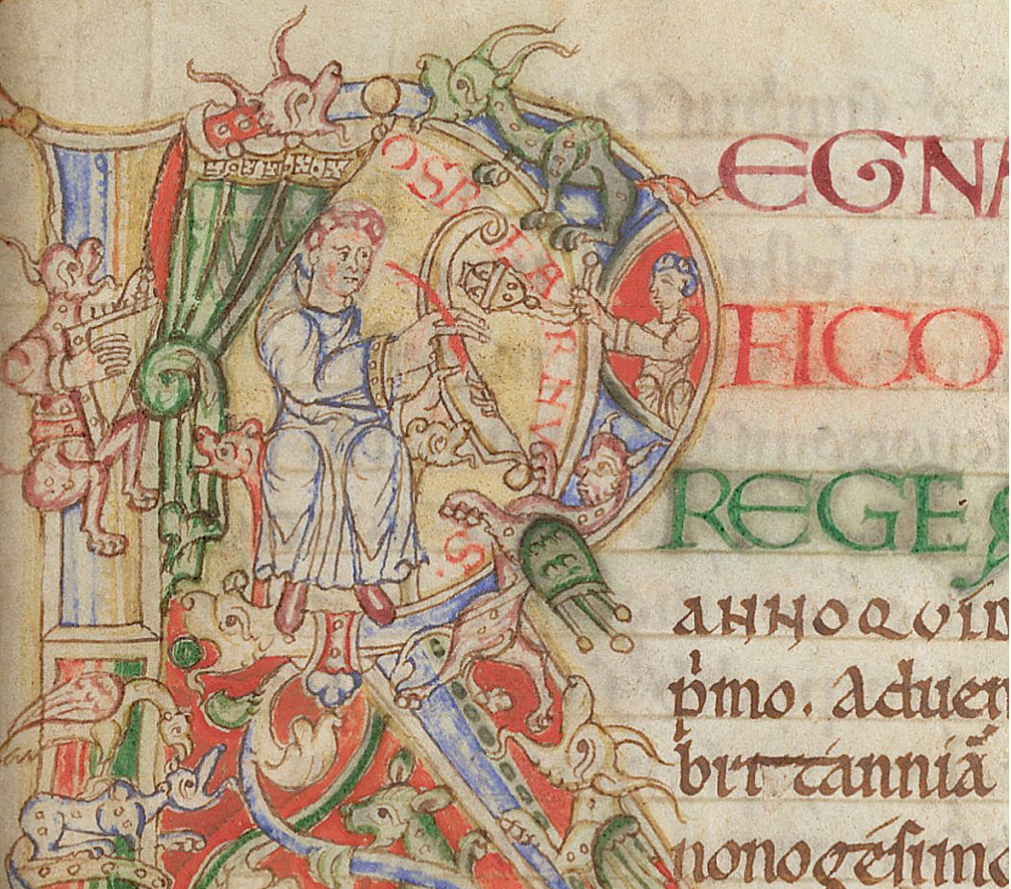
Writing
Rule the parchment (lead point or coloured ink)
Write with quill (goose or swan feather cut to form a nib) dipped into ink
Erase mistakes by scraping ink off with knife
British Library, MS. Arundel 16, f. 12. Detail of historiated initial 'R'(ege) with a scribe, a censing monk, and other creatures.
Notes:
87

Slide 6
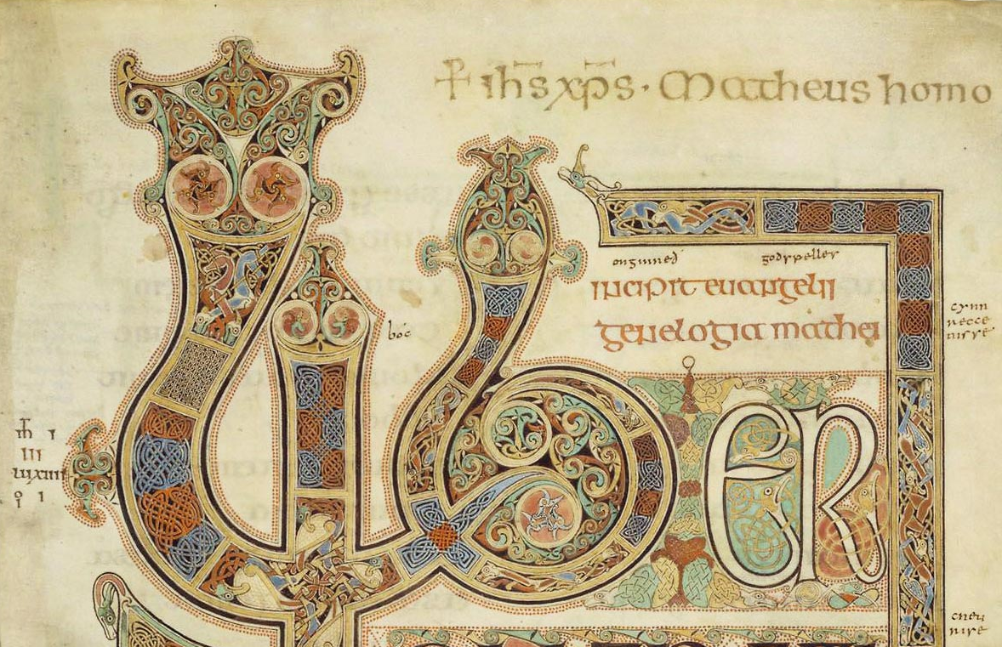
Illumination
Apply gold leaf
Image: British Library, The Lindisfarne Gospels (London, British Library Cotton MS Nero D.IV), early 8th c.

Slide 7
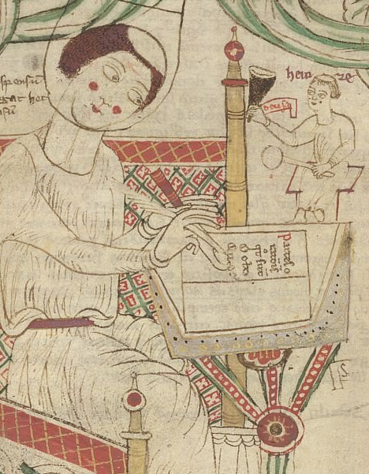
Writing
British Library, MS. Arundel 43, f. 80v . Donatus writing his Grammar.
Rule the parchment (lead point or coloured ink)
Write with quill (goose or swan feather cut to form a nib) dipped into ink
Erase mistakes by scraping ink off with knife
British Library, MS. Arundel 16, f. 12. Detail of historiated initial 'R'(ege) with a scribe, a censing monk, and other creatures.
Notes:
87

Slide 8
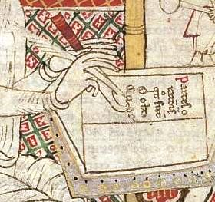
Notes:
87

Slide 9
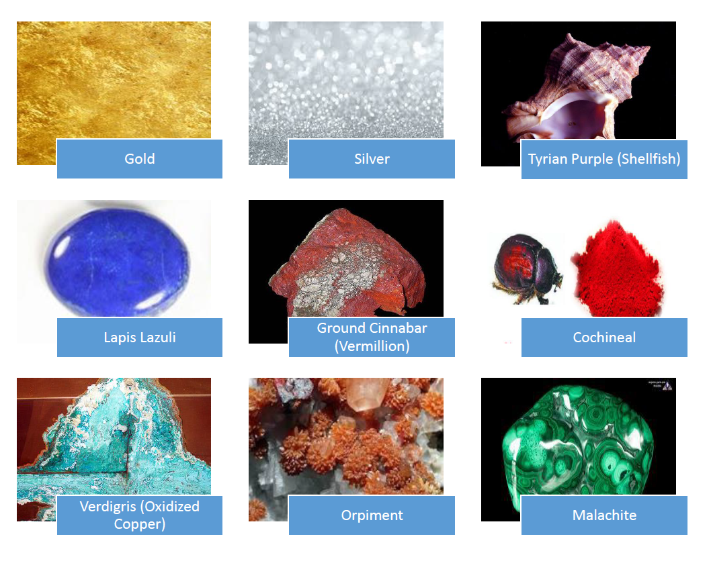

Slide 10
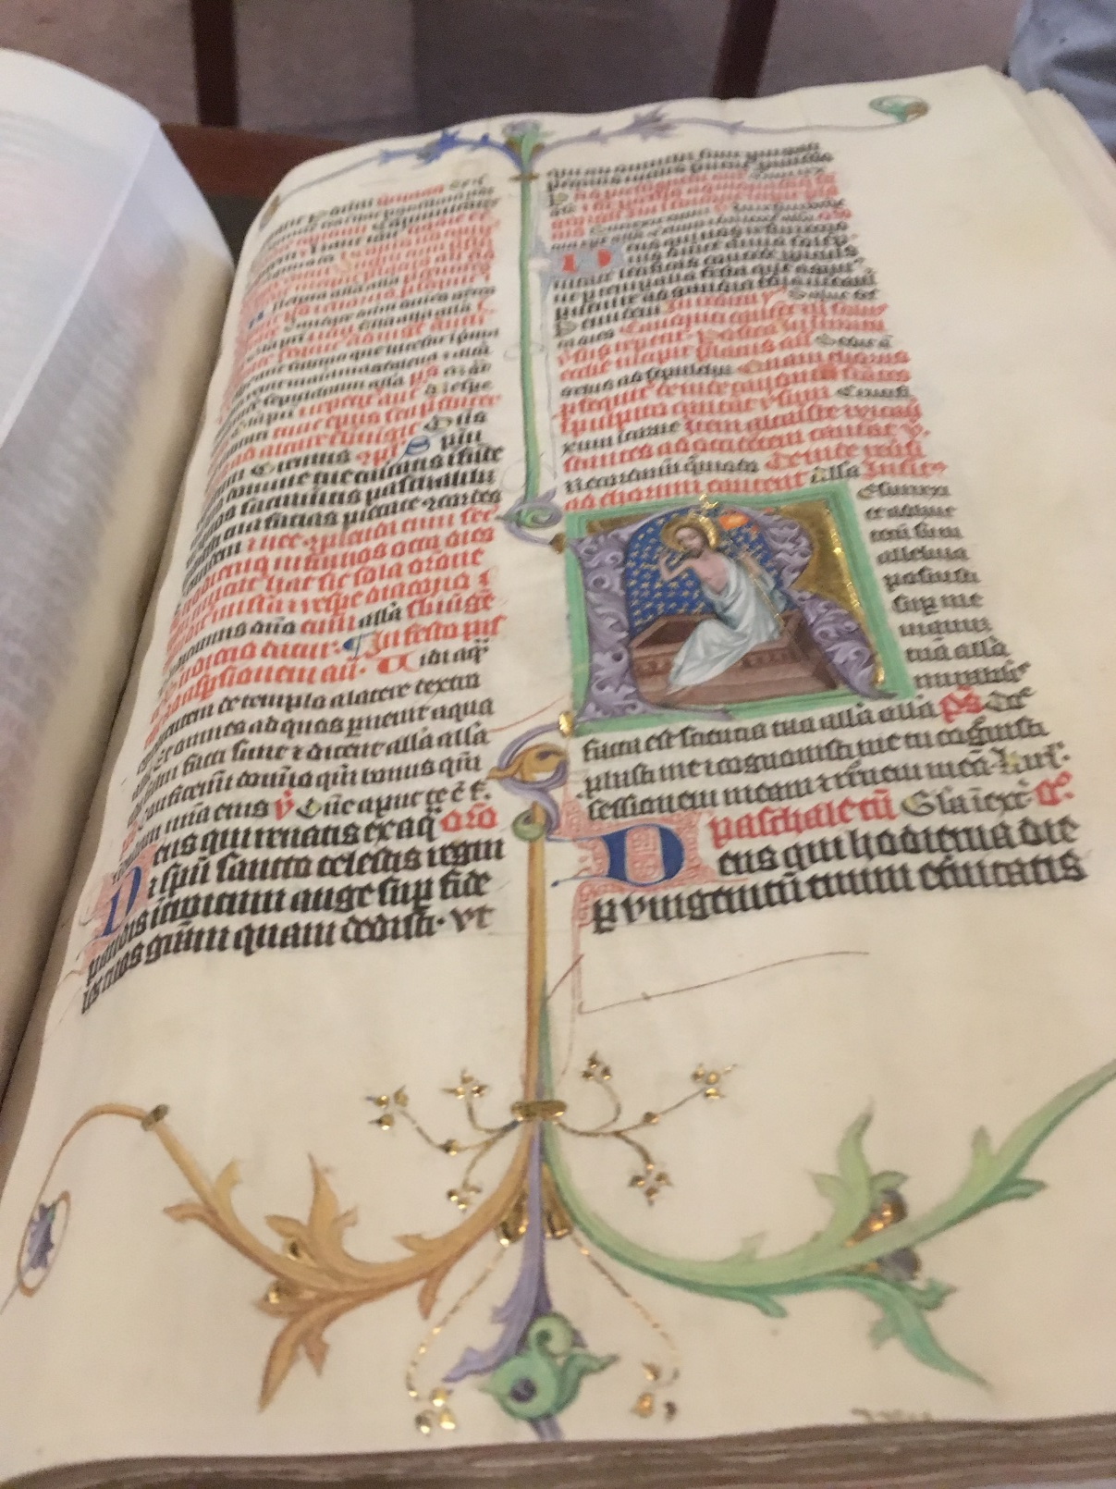

Slide 11
Early Printed Books

Slide 12
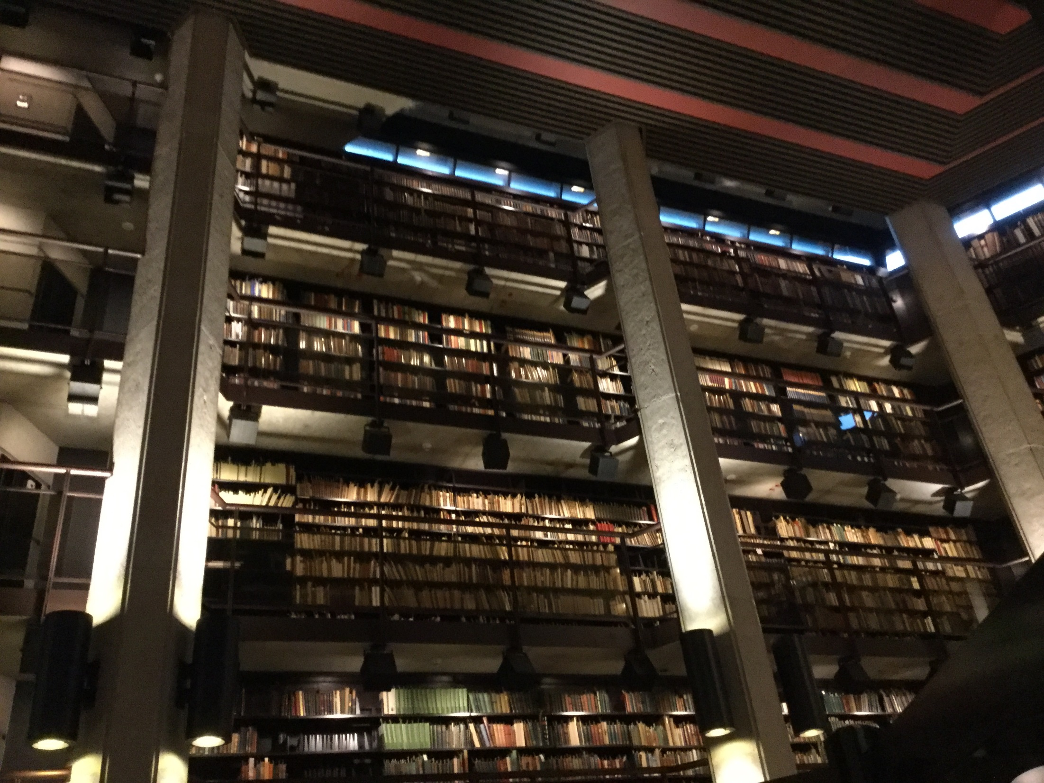

Slide 13
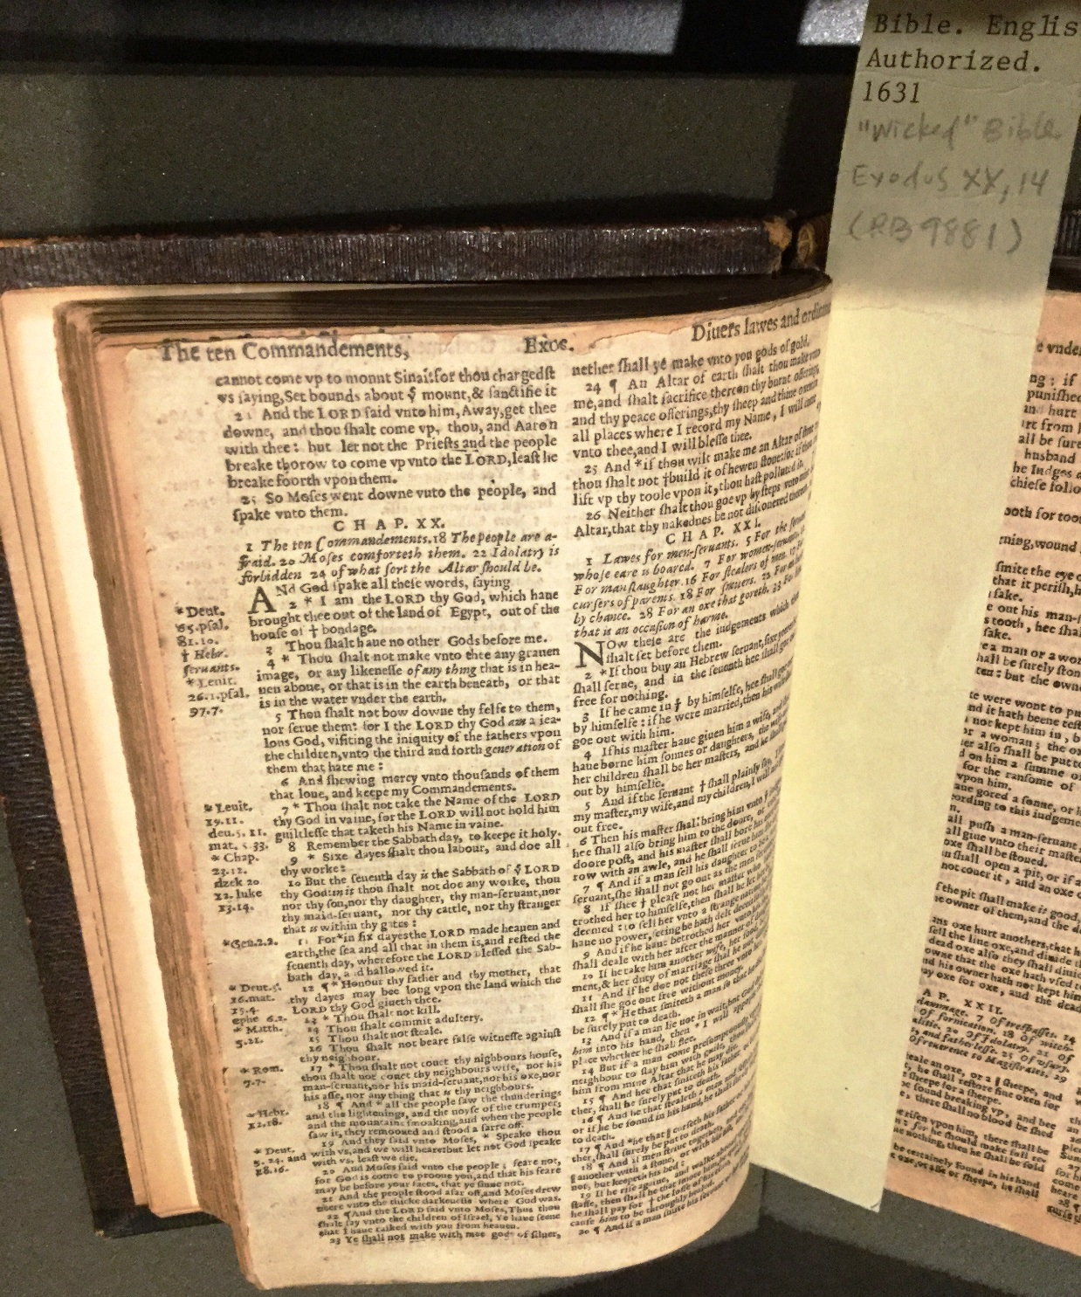
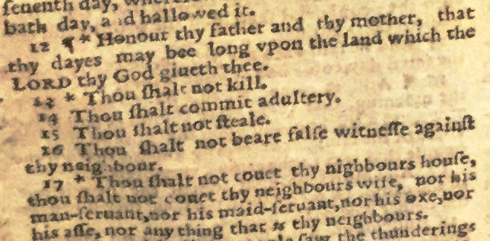
“Wicked” Bible. Thomas Fisher Rare Books Library.
(AB)

Slide 14

https://youtu.be/EMjhNhQsqsg
https://youtu.be/EMjhNhQsqsg

Slide 15
Making & Sustaining Digital Archives

Slide 16
Overview
Old English Riddles (Exeter Book 47)
Making Digital Archives
Using & Sustaining Digital Archives

Slide 17
Moððe word fræt. Me þæt þuhte wrætlicu wyrd, þa ic þæt wundor gefrægn, þæt se wyrm forswealg wera gied sumes, þeof in þystro, þrymfæstne cwide ond þæs strangan staþol. Stælgiest ne wæs wihte þy gleawra, þe he þam wordum swealg.
A moth ate words. That seemed to me a marvellous happening, when I heard about that wonder, that the worm swallowed up a certain man’s song, the thief in darkness, a glory-fast speech and its strong foundation. The stealing guest was not at all the wiser, for those words he swallowed.
Notes:
I want to begin with a riddle. It’s from the Old English Exeter Book, a tenth-century manuscript that contains Old English poetry and prose—and includes a collection of riddle poems, like this one. The most frequent solution is Moth or Bookworm: a creature that devours books and so swallows up human knowledge and its “strong foundation” without understanding.
87

Slide 18
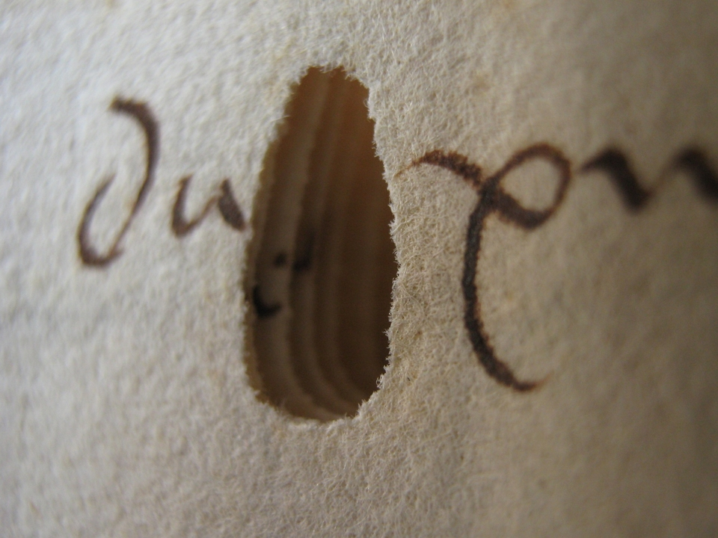
Bookworm Damage
Eric Kwakkel, “Killer bookworm holes”; Image: 15th-century manuscript in Dubrovnik archives, photographed by Emir O Filipovic (@EmirOFilipovic).
Notes:
Here’s an example of bookworm damage in a manuscript. Eric Kwakkel writes: “The most peculiar thing about the holes [bookworms] left behind is that they usually stop halfway the book. It is as if the worm, finished with his meal, turned around and traced his steps back to the restaurant’s exit. Like a satisfied customer.”
87

Slide 19
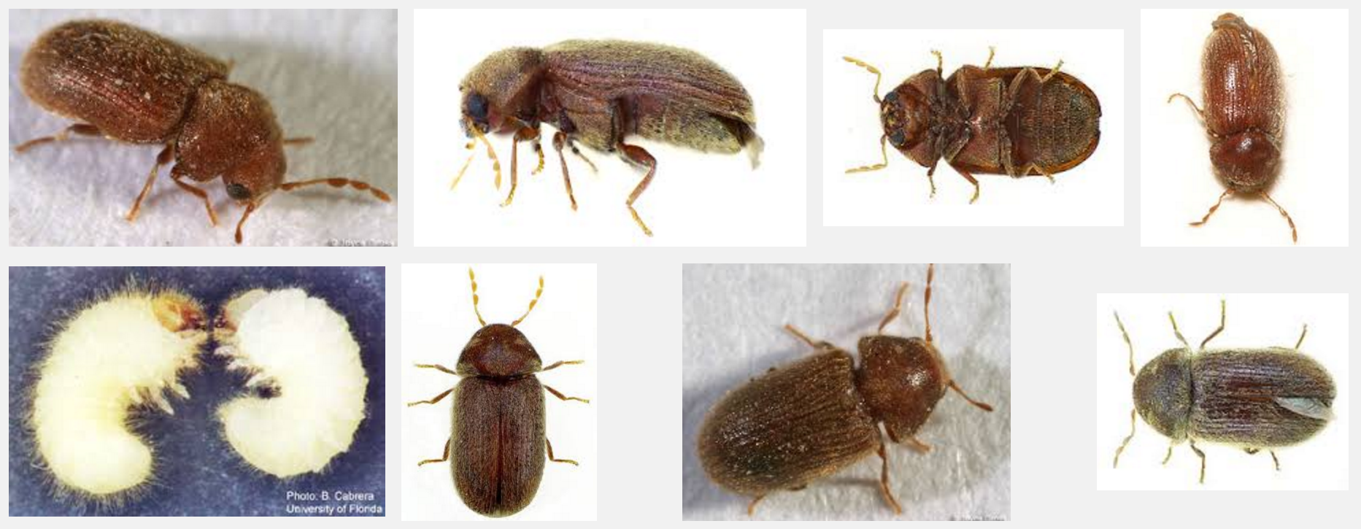
Notes:
Bookworms: Insect images
87

Slide 20
Making Parchment
Parchment = stretched and processed animal skin (goat, sheep, calf, cow)
(but see also: anthropodermic bibliopegy)
Domestic sheep. Public Domain, https://commons.wikimedia.org/w/index.php?curid=16818.
Notes:
87

Slide 21
Making Parchment
Skin is soaked in lime solution to loosen animal hair
Animal hair removed with curved knife
Skin wetted and stretched on special rack
Pictured: Skin of a stillborn goat on a stretcher. Modern parchment making. J. Paul Getty Museum (https://www.getty.edu/art/exhibitions/making/zoom_parchment.html)
Notes:
87

Slide 22
Writing
British Library, MS. Arundel 43, f. 80v . Donatus writing his Grammar.
Rule the parchment (lead point or coloured ink)
Write with quill (goose or swan feather cut to form a nib) dipped into ink
Erase mistakes by scraping ink off with knife
Notes:
87

Slide 23
Notes:
87

Slide 25
Moððe word fræt. Me þæt þuhte wrætlicu wyrd, þa ic þæt wundor gefrægn, þæt se wyrm forswealg wera gied sumes, þeof in þystro, þrymfæstne cwide ond þæs strangan staþol. Stælgiest ne wæs wihte þy gleawra, þe he þam wordum swealg.
A moth ate words. That seemed to me a marvellous happening, when I heard about that wonder, that the worm swallowed up a certain man’s song, the thief in darkness, a glory-fast speech and its strong foundation. The stealing guest was not at all the wiser, for those words he swallowed.
Notes:
I want to begin with a riddle. It’s from the Old English Exeter Book, a tenth-century manuscript that contains Old English poetry and prose—and includes a collection of riddle poems, like this one. The most frequent solution is Moth or Bookworm: a creature that devours books and so swallows up human knowledge and its “strong foundation” without understanding.
87

Slide 26
Traditional Associations
“wyrd” (fate) -- splendid buildings in ruins; the death of kings, warriors, civilization; the destructiveness of time
“wyrm” (worm) -- dragon

Slide 27
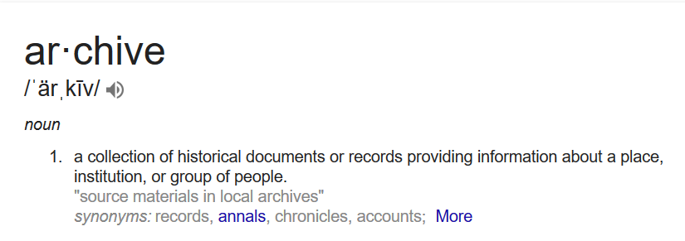
Notes:
An archive is a collection of historical documents or records providing information about a place, an institution, or a group of people.
87

Slide 28
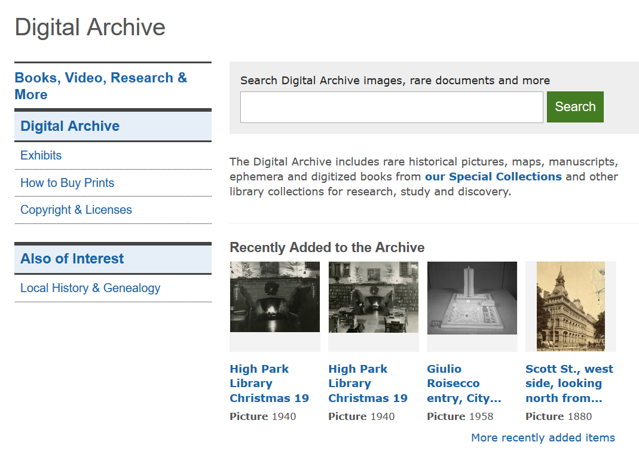
Toronto Public Library Digital Archive: Print Media, Digitized
Notes:
Digital archives can originate with print media, like the Toronto Public Library Digital Archive.
87

Slide 29
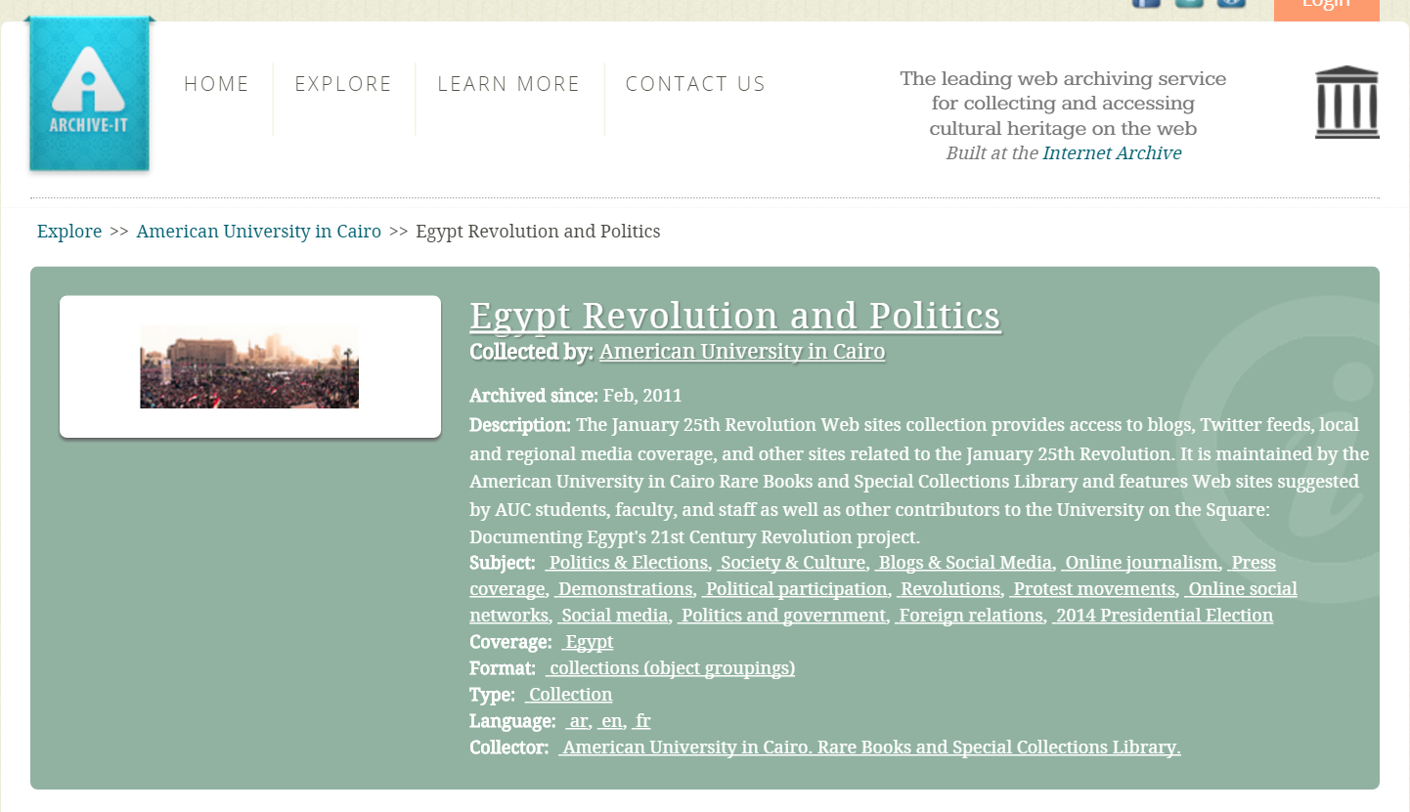
Digital Archives: Egyptian Revolution (Born Digital)
https://archive-it.org/collections/2358
http://guides.library.cornell.edu/c.php?g=31688&p=200748
https://storify.com/acarvin/new-story-2
Notes:
Other archives are born digital. Here is an archive of social media activity during the Egyptian revolution of 2011: tweets, blogs, Facebook posts, and so on. This is maintained by the American University in Cairo in partnership with the Internet Archive.
87

Slide 30
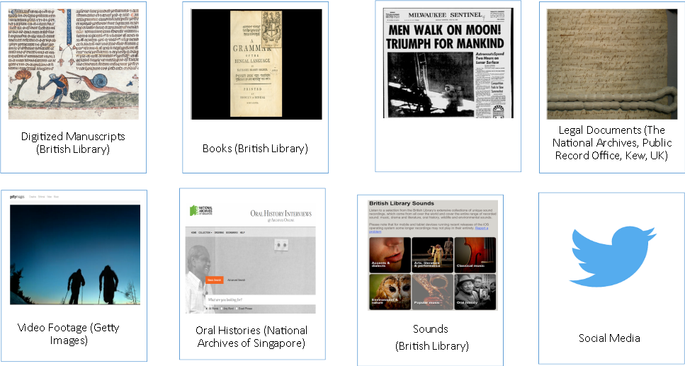
Newspapers (Google Digitization)
Notes:
Archives consist of records: digitized manuscripts, books, newspapers, legal documents, video footage, oral histories, sounds, tweets.
87

Slide 31
Born-Digital Projects

Slide 32
Digitizing Parchment & Paper

Slide 33
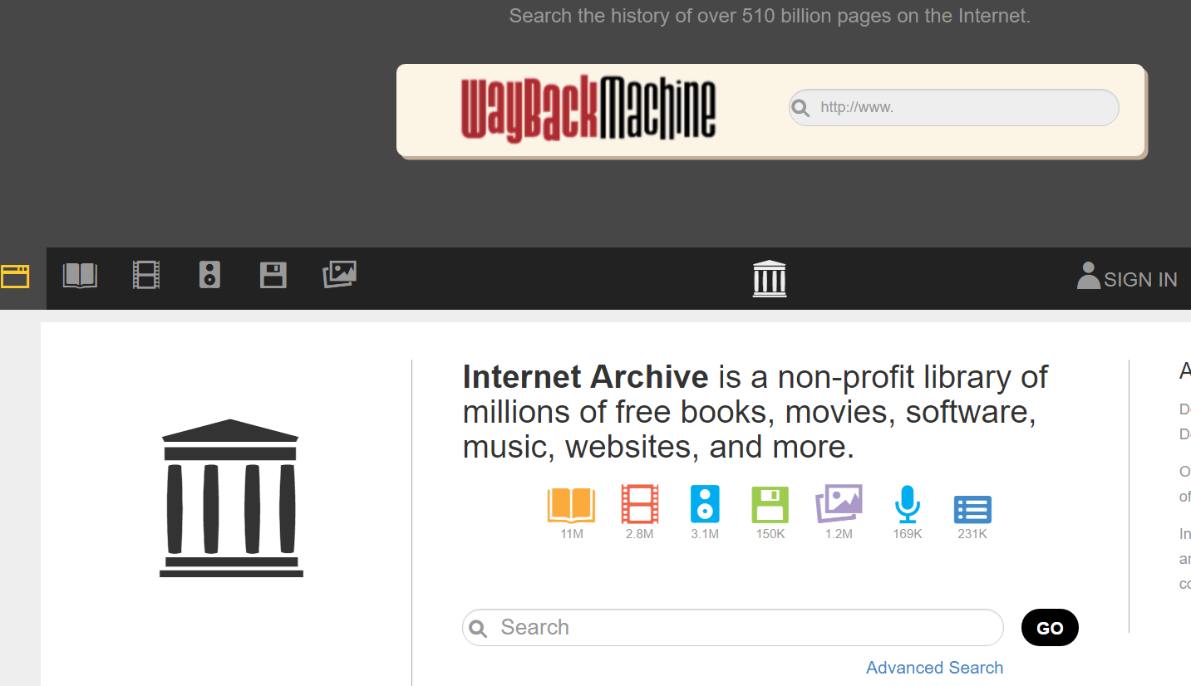
Notes:
How are digital archives created? For my first example—the digitization of physical collections--I want to draw on work at the Internet Archive—work I had the privilege of witnessing thanks to Andrea Mills, at the Internet Archive scanning centre here in Robarts Library. The Internet Archive, a San Francisco–based nonprofit digital library whose stated mission is "universal access to all knowledge". The Internet Archive provides free public access to collections of digitized materials, including books, movies, software, music, and websites. On the 7th floor of Robarts, the Internet Archive digitizes books—from Fisher Rare Books Library; from other UofT libraries; and from all over Canada. In the slides that follow, I want to trace the journey of these materials from physical artifact to digital surrogate.
87

Slide 34
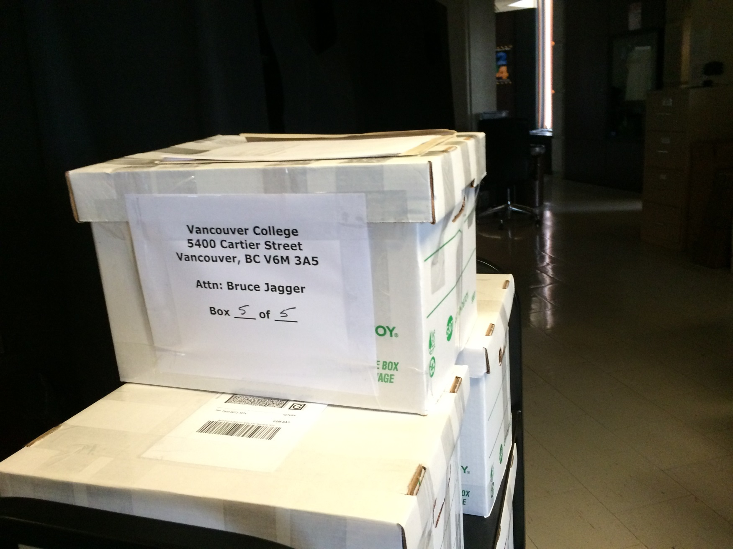
Internet Archive: Materials for digitization. Photo: A. Bolintineanu, 2016.
Notes:
Digitization requires very specialized equipment and expertise. Before digitization can begin, materials travel to the scanning centre. Some books travel in humble cardboard boxes, like this stack of yearbooks from Vancouver College.
87

Slide 35
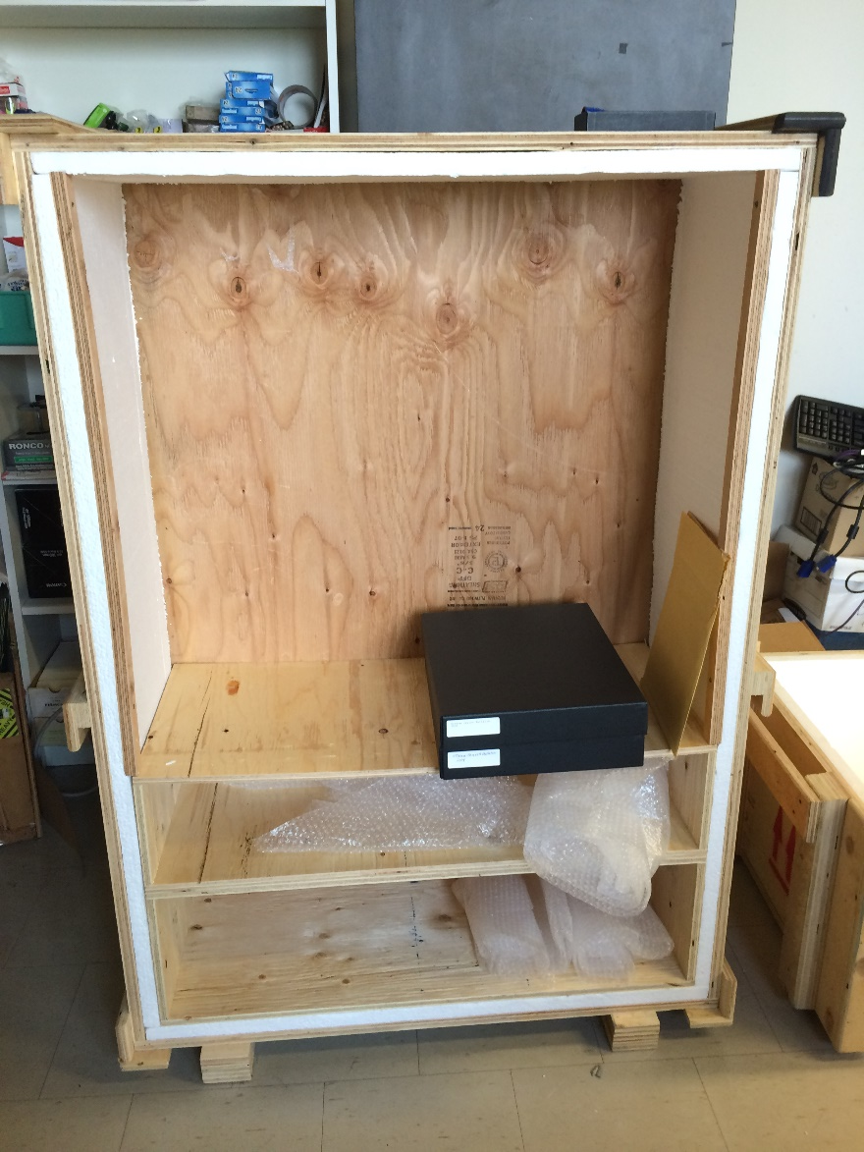
Internet Archive: Materials for digitization. Photo: A. Bolintineanu, 2016.
Notes:
Other materials travel in style—in this case, in enclosed archival boxes that themselves travel in padded wooden crates very much like vampire coffins (because, like vampires, these books are fragile and long-lived, travellers from an earlier time).
87

Slide 36
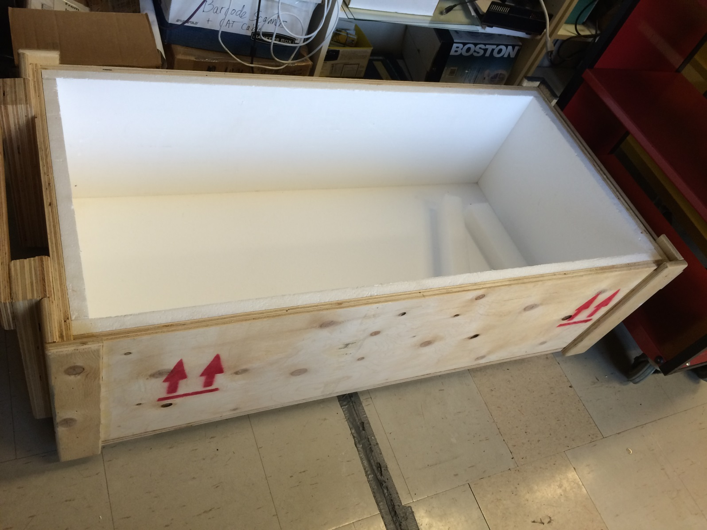
Internet Archive: Materials for digitization. Photo: A. Bolintineanu, 2016.
Notes:
Here’s the vampire coffin.
87

Slide 37
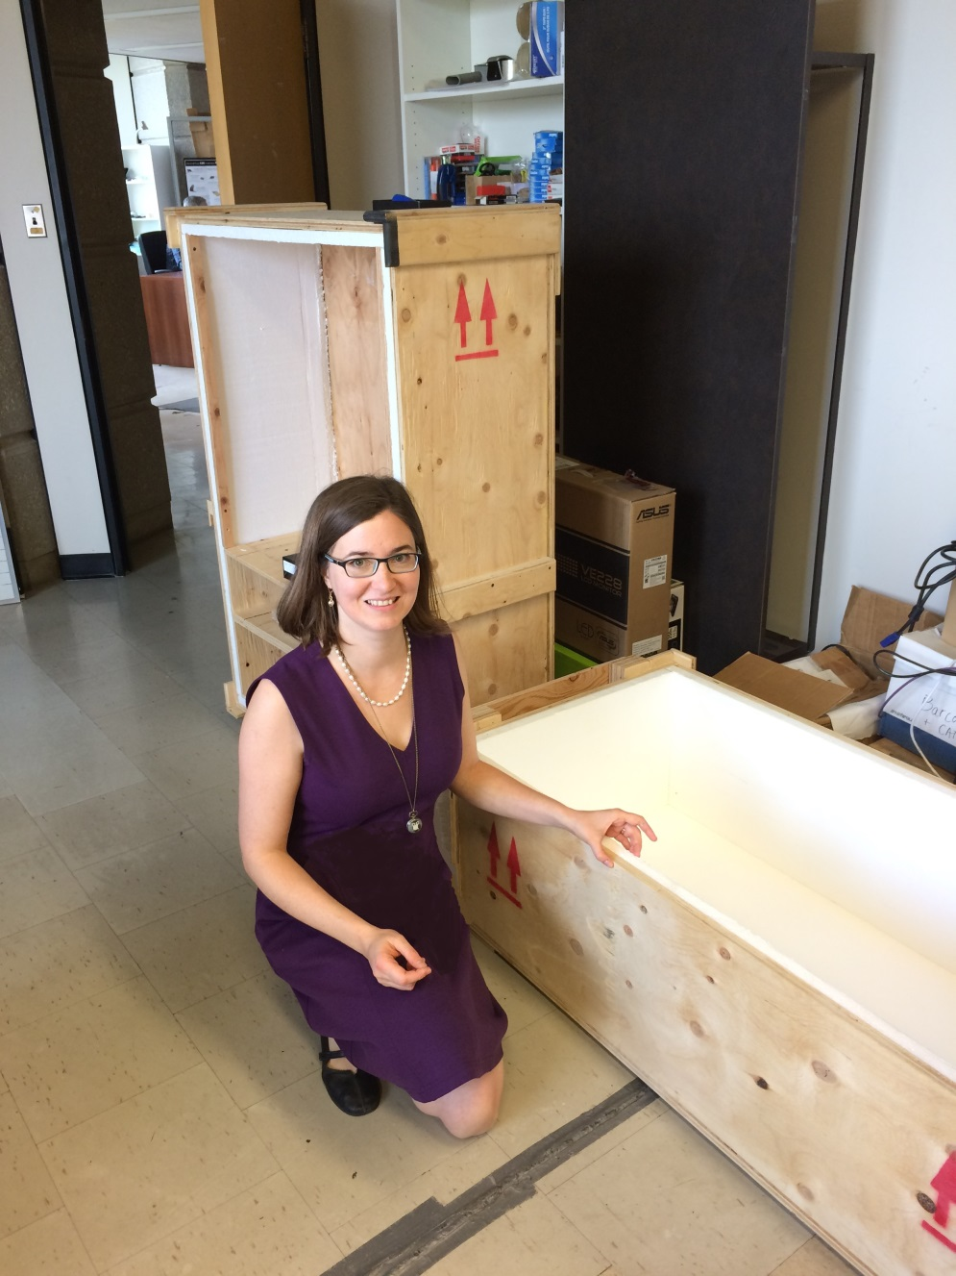
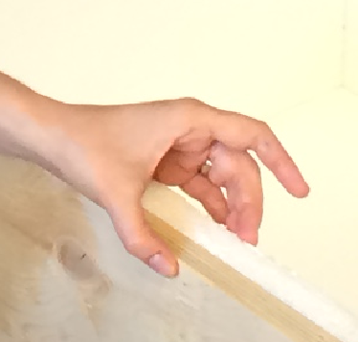
Internet Archive: Materials for digitization. Photo: A. Bolintineanu, 2016.
Notes:
Here is a human being, for scale. My disembodied hand indicates the thickness of the padding of the box in which the boxes of archival materials were stored.
87

Slide 38
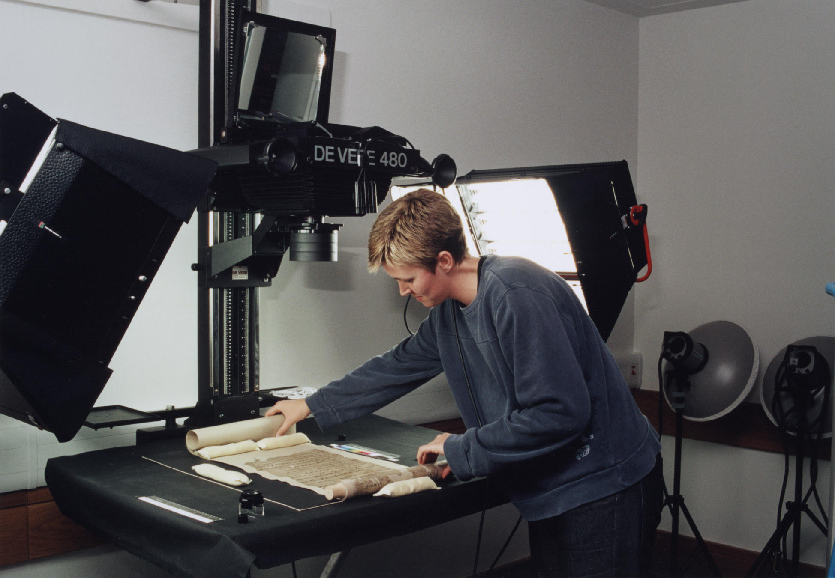
Digitizing Manuscripts
Digitisation of a Dunhuang manuscript (Pictured: De Vere 480 camera. Wikipedia: International Dunhuang Project, 2006.)
Notes:
Once you have assembled your material, digitization work can begin. You’ll need a specialized camera that can capture the colours of your manuscript, the tiny details (some not visible to the naked eye), erasures, scribal doodles, the marginal notes written by scribes and readers over the years, even bookworm damage. You’ll need a cradle to support the manuscript. You’ll need a conservation-friendly room, where you can control all the light sources, to make sure you take the clearest, most accurate photograph.
87

Slide 39
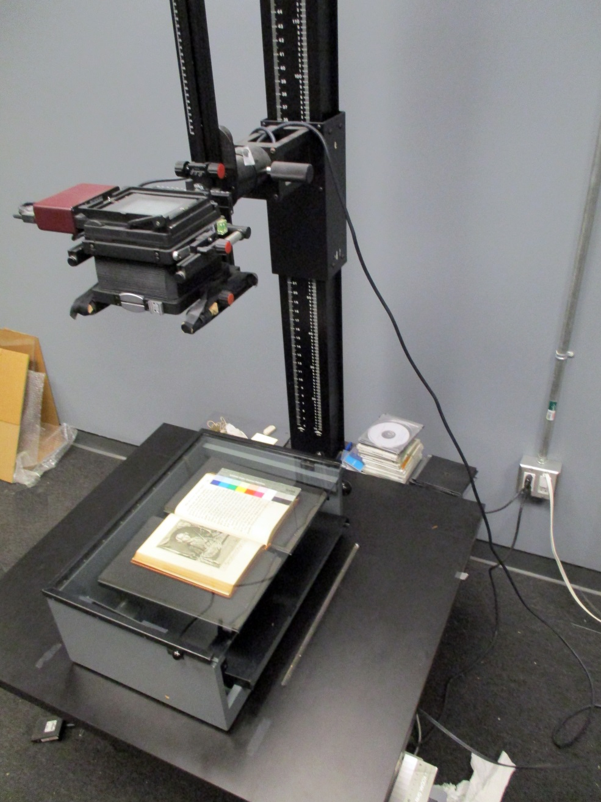
Digitizing Printed Books
Digitizing Books at the Fisher Library (Photo: Paul Armstrong, 2016)
Notes:
Here is a specialized scanner as used by the Fisher Library. Notice the black book cradle under the book, and colour calibration strip on the right-hand side of the book. These help ensure archival-quality images.
87

Slide 40
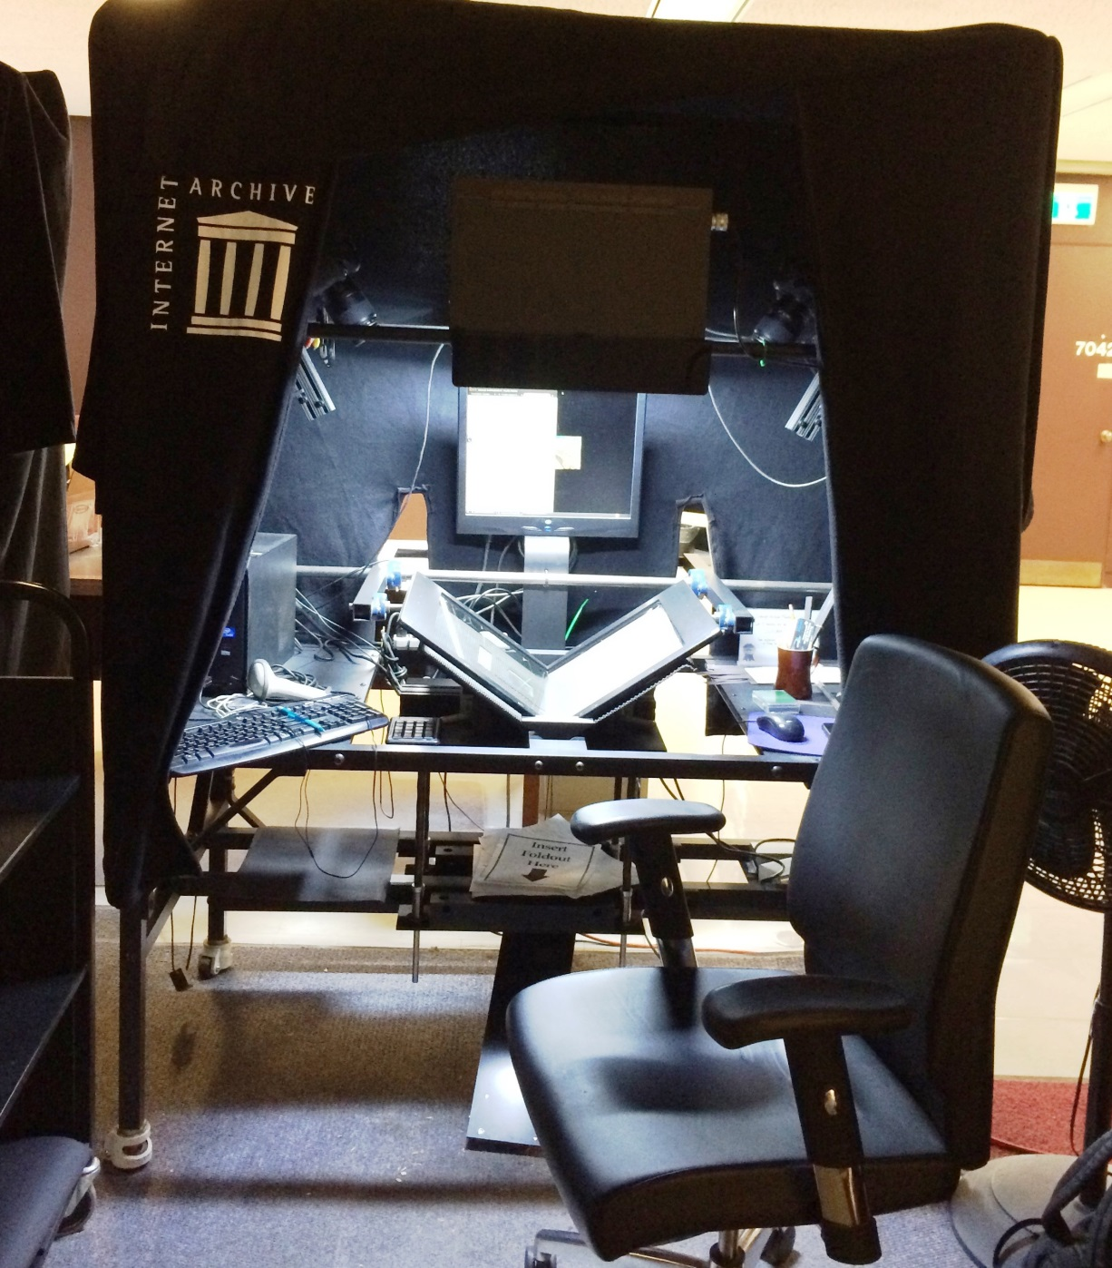
Digitizing Printed Books
Digitizing Books at the Internet Archive, University of Toronto (Photo: Alexandra Bolintineanu, 2016)
Notes:
Here is a specialized scanning station from the Internet Archive’s outpost on the seventh floor of Robarts. Notice the curtains around the station, ensuring a minimum of light interference; the bright light on the scanner itself; the computer screen, to check the quality of the scan; and the book cradle, holding the book half-open so as not to injure its spine. On the seventh floor of Robarts, in the Internet Archive’s quarters, there are seven or eight such digitization stations, each in its own cocoon of drapery and with its own overhead light.
87

Slide 41
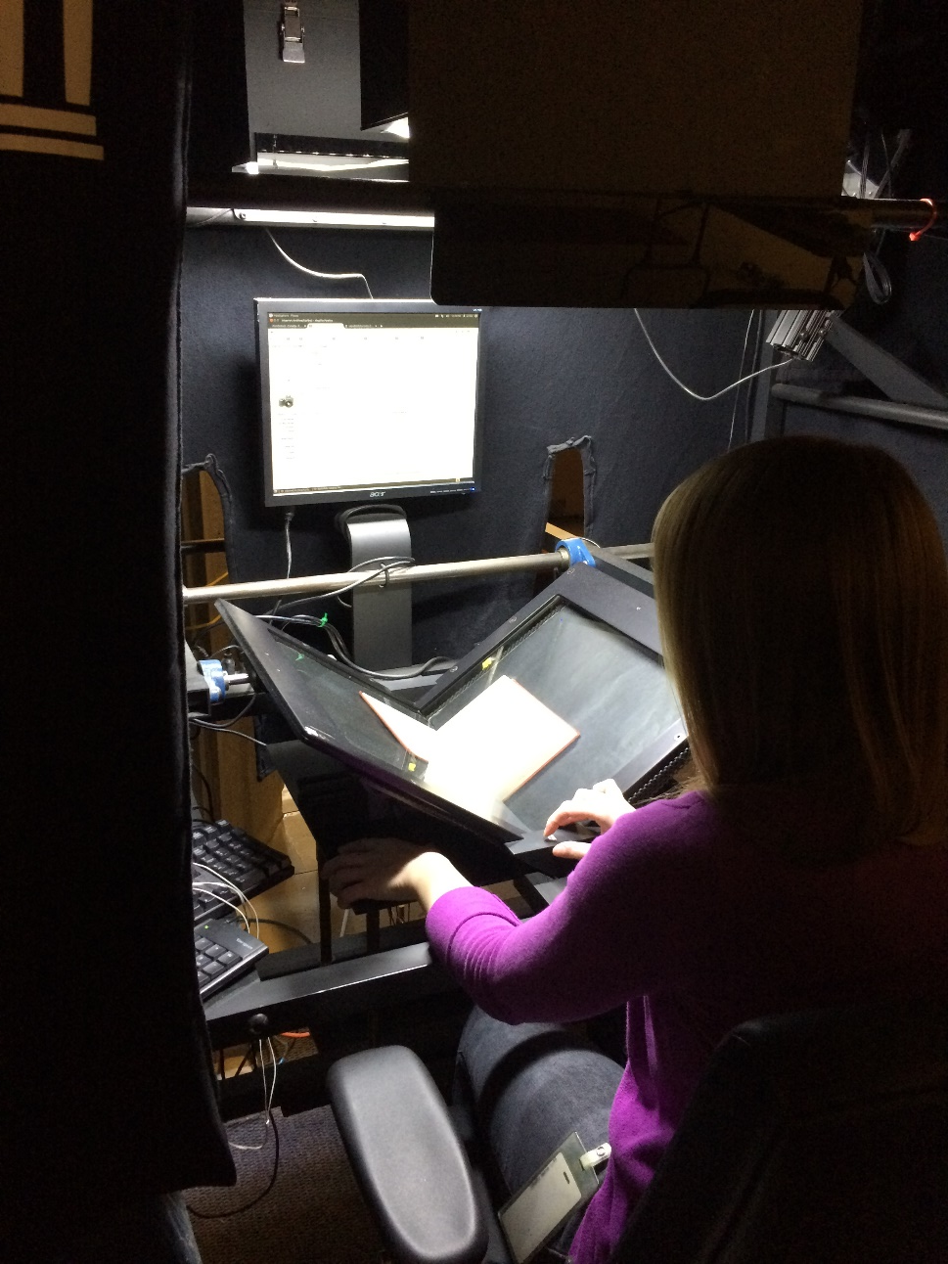
Digitizing Printed Books
Digitizing Books at the Internet Archive, University of Toronto (Photo: Alexandra Bolintineanu, 2016)
Notes:
The scanning bed is angled, forming a book cradle that allows a book to sit partially open. This supports fragile spines and bindings.
<number>

Slide 42
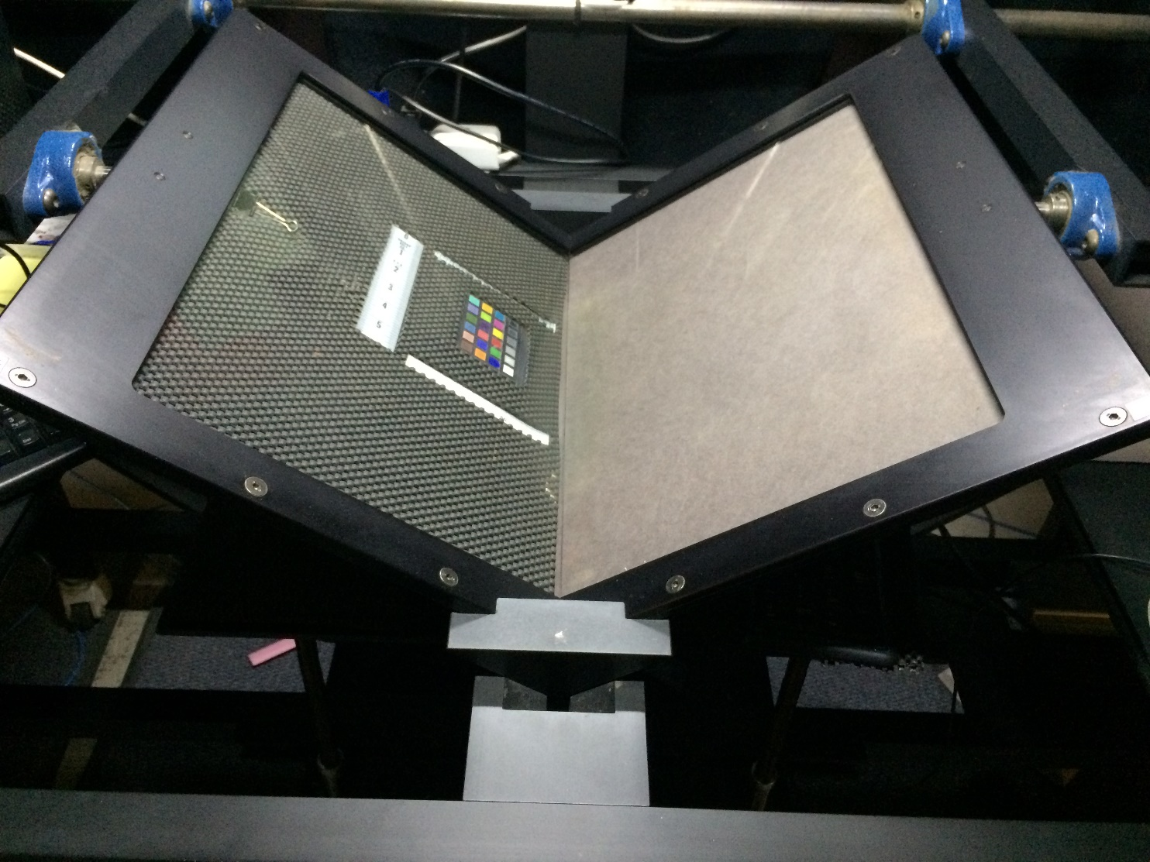
Digitizing Printed Books
Digitizing Books at the Internet Archive, University of Toronto (Photo: Alexandra Bolintineanu, 2016)
Notes:
Colour reference sheets help calibrate the scanner, ensuring the colours it records in its images are as accurate as possible.
<number>

Slide 43
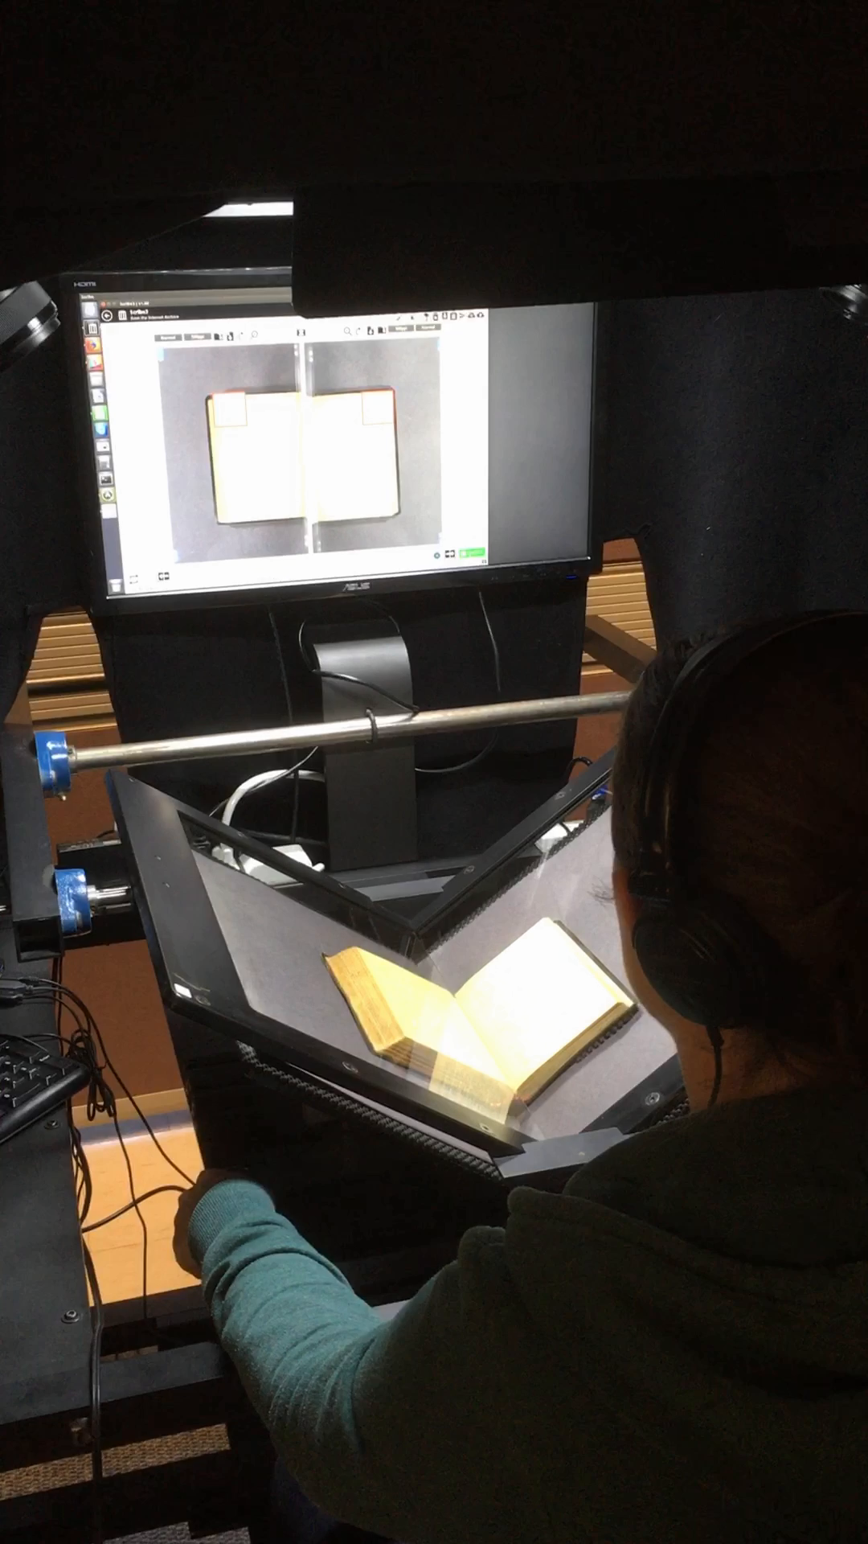
Digitizing Printed Books
Digitizing Books at the Internet Archive, University of Toronto (Photo: Alexandra Bolintineanu, 2018)
Notes:
Colour reference sheets help calibrate the scanner, ensuring the colours it records in its images are as accurate as possible.
<number>

Slide 44
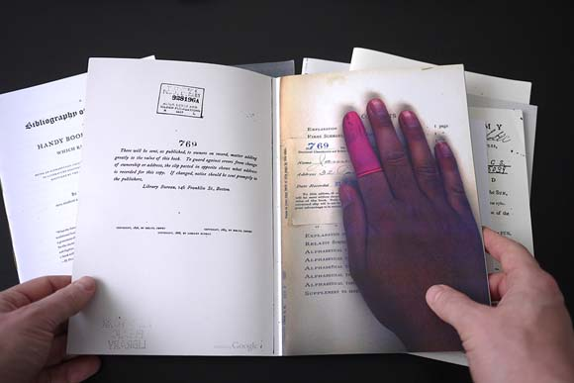
Digitization Errors
Image: “Special Collection” (2009), by Benjamin Shaykin. Photo by the Library of the Printed Web. Cited by Kenneth Goldsmith, “The Artful Accidents of Google Books,” The New Yorker (December 4, 2013).
Notes:
Not from the Internet Archive, but from Google Books, here is an example of digitization error: the hand of a scanner operator appear in digitized Google Books.
<number>

Slide 45
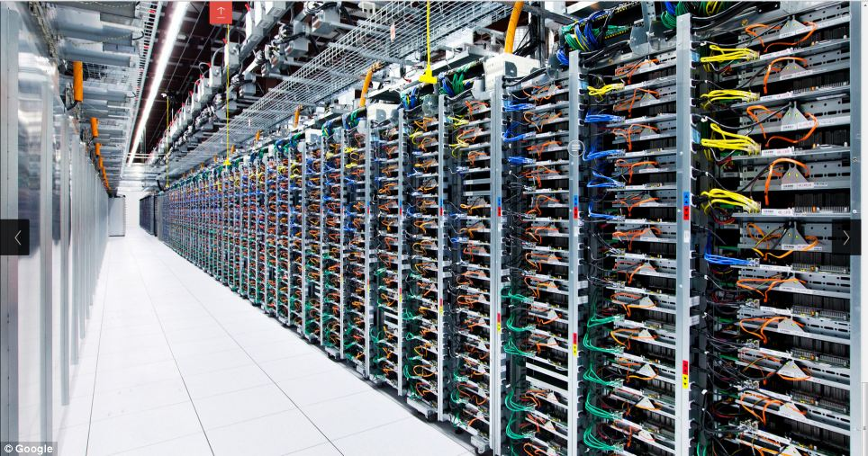
Google Data Centre: Server Farm
Image: Google, Data Centre Gallery (https://www.google.com/about/datacenters/gallery)

Slide 46
“The Mirror of the World & Its Memory”
Notes:
<number>

Slide 47
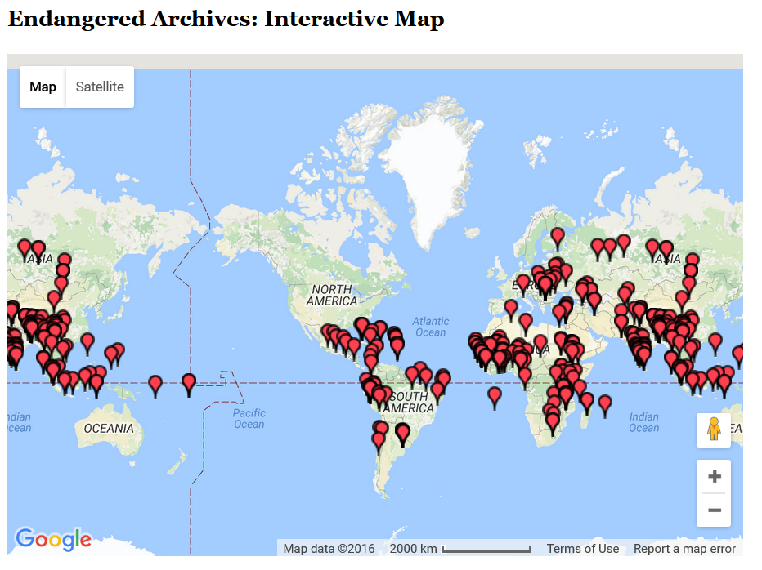
British Library, Endangered Archives Programme
http://eap.bl.uk/database/map.a4d

Slide 48
“Documentary heritage reflects the diversity of languages, peoples and cultures. It is the mirror of the world and its memory. But this memory is fragile. Every day, irreplaceable parts of this memory disappear for ever.”
UNESCO Memory of the World Programme,
quoted by the British Library, Endangered Archives Programme

Slide 50
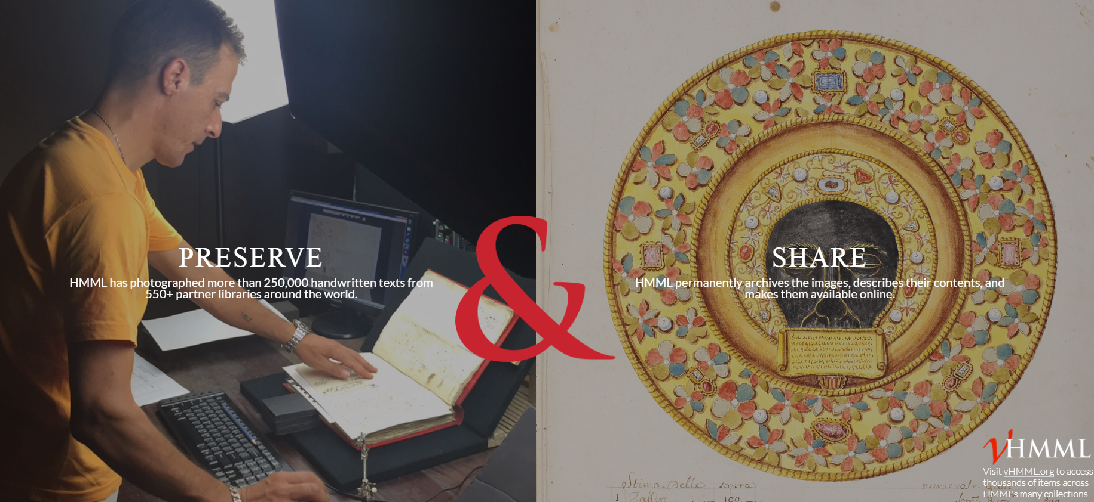
Digital Imaging of Endangered Books

Slide 51
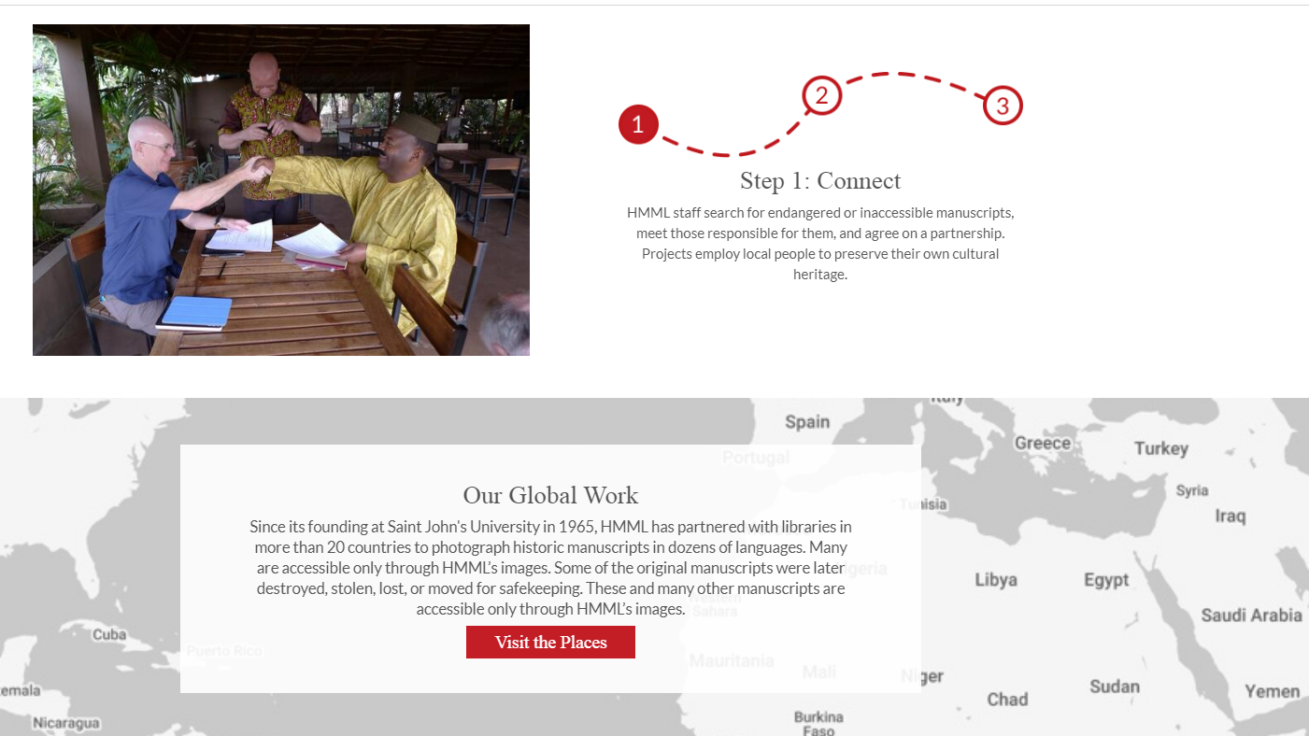

Slide 52
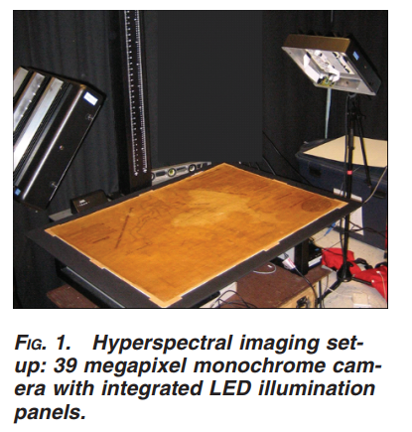
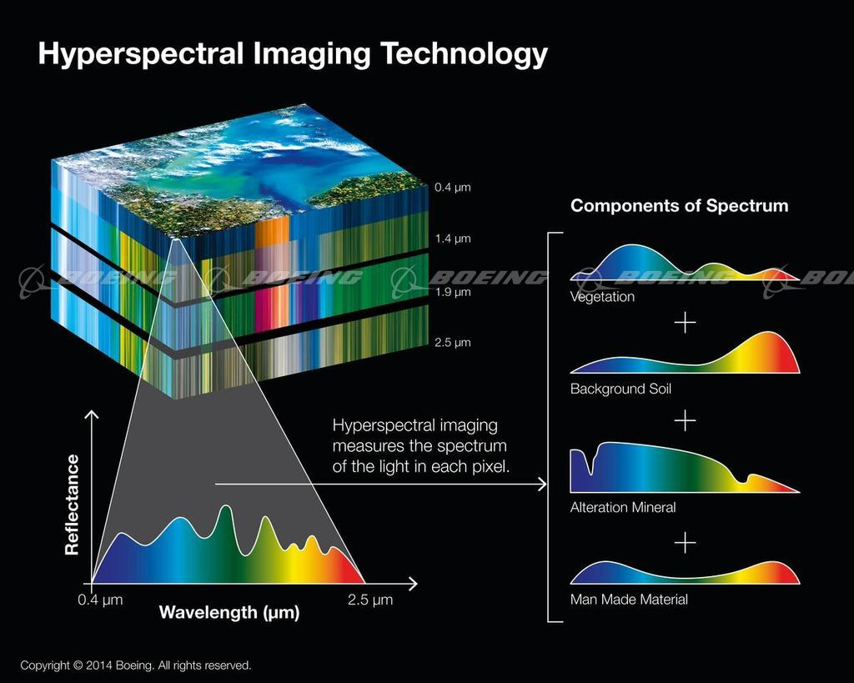
Hyperspectral or Multispectral Imaging

Slide 53
Hyperspectral or Multispectral Imaging
“a powerful, noncontact technique with a range of capabilities. The critical component of the advanced spectral imaging is the capability for chemical characterization of materials, providing both access and enhanced non-visible and visible information in registered high-resolution digital images. This noncontact tool can identify and characterize colorants, inks, and substrates through their specific spectral response, monitor deterioration or changes due to exhibit and other environmental conditions, assess and potentially identify previous treatments that modify chemical and spectral responses of cultural heritage materials…” (Fenella G. France et al)

Slide 54
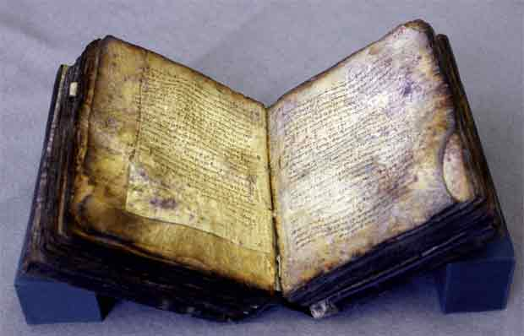
Archimedes Codex
https://www.ted.com/talks/william_noel_revealing_the_lost_codex_of_archimedes
http://archimedespalimpsest.net/Data/

Slide 55
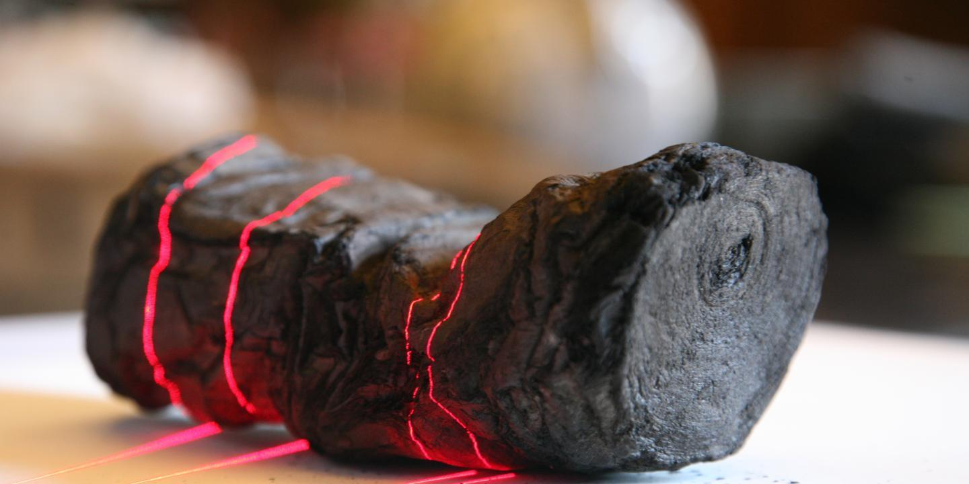
Herculaneum Scrolls
“A papyrus scrolls from Herculaneum, which was carbonized in the eruption of Mt. Vesuvius, undergoes part of the CT scan process to help decipher the writing contained within the scrolls, in an image from the University of Kentucky's Center for Visualization and Virtual Environments taken in 2009.” (https://www.newsweek.com/2016/01/29/x-rays-reveal-secrets-egyptian-scrolls-papyrus-416719.html)
Notes:
<number>

Slide 56
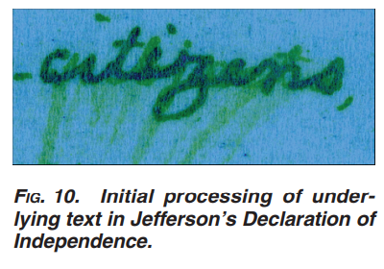
The Declaration of Independence (draft)
Patriots? Residents?
Fenella G. France and Michael B. Toth. 2011. “Spectral imaging for revealing and preserving world cultural heritage.” The Institute of Electrical and Electronics Engineers, Inc. (IEEE) Conference Proceedings, 08/2011, pp. 1450 – 1454.
See also: Marc Kaufman. “Jefferson changed 'subjects' to 'citizens' in Declaration of Independence.” The Washington Post, July 3, 2010.

Slide 57
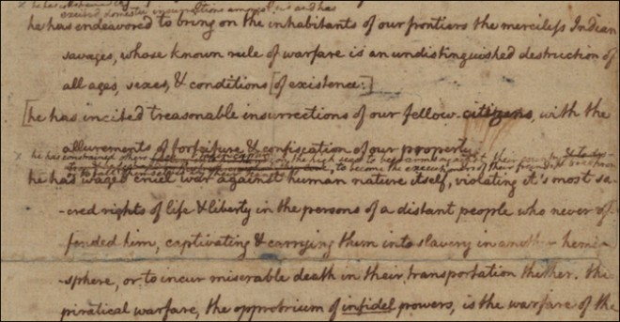
The Declaration of Independence (draft)

Slide 58
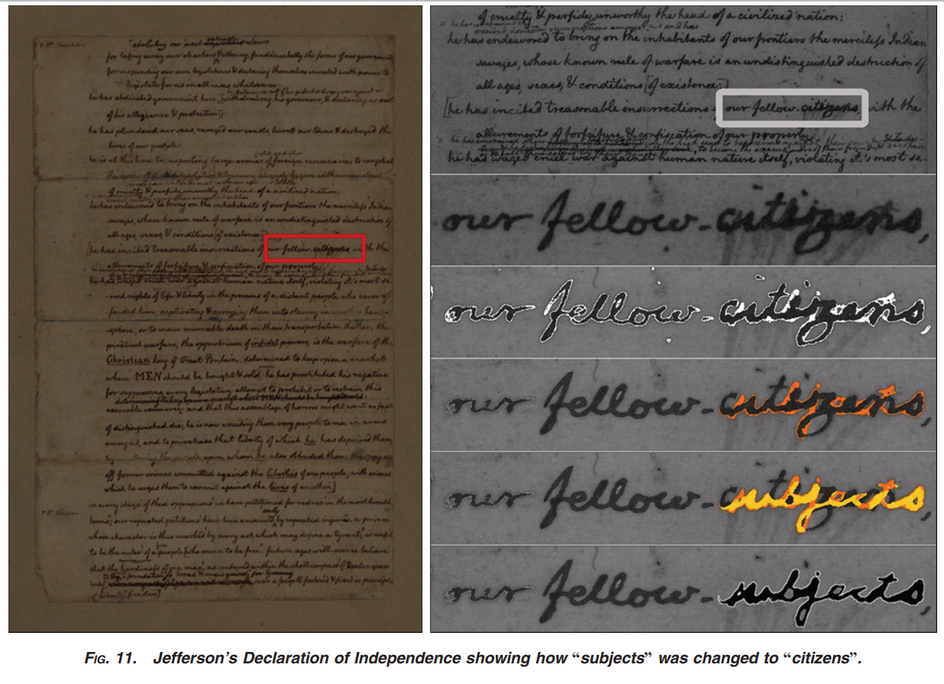

Slide 60
Risks to Digital Archives

Slide 61
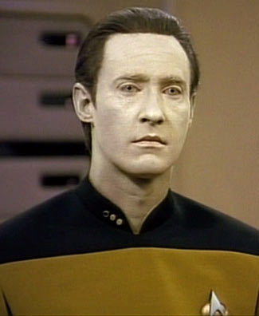
LOST
DATA

Slide 62
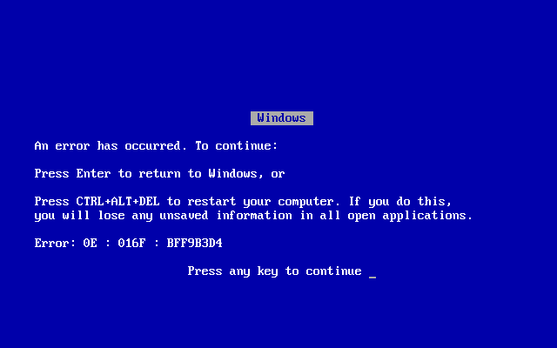
Risks to Digital Archives
Image: 15th-century manuscript in Dubrovnik archives, photographed by Emir O Filipovic (@EmirOFilipovic).
Image: Windows Blue Screen of Death (Wikipedia, original uploader: Akhristov at English Wikipedia. Public Domain.)
Notes:
Digital archives are not vulnerable to bookworms. But they are fragile – more fragile – in different ways. To illustrate this fragility, let’s consider the story of the two Doomsday Books.
<number>

Slide 63
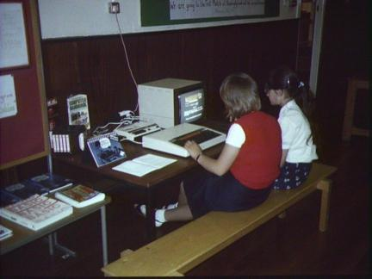
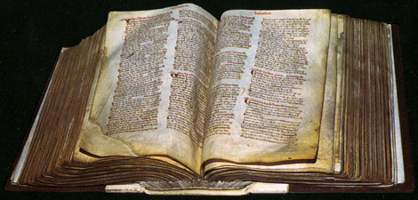
Doomsday Book
1086
1986
Notes:
Let me tell you the story of the two Doomsday Books. The firsts is a Latin manuscript of the eleventh century: for taxation purposes, William the Conqueror ordered a record made of landholders and their property in much of England and parts of Wales. The book was finished in 1086 and it resides at The National Archives at Kew, London.
The second Doomsday Book was a BBC initiative, 900 years later: an attempt to build a “digital snapshot of the country,” a documentation of everyday life in communities around the United Kingdom. Over a million people contributed.
<number>

Slide 64
The BBC Domesday Project was stored on adapted laser discs. Reading these discs required a state-of-the-art microcomputer, the Acorn BBC Master, customized with a specially produced laserdisc player.

Slide 65
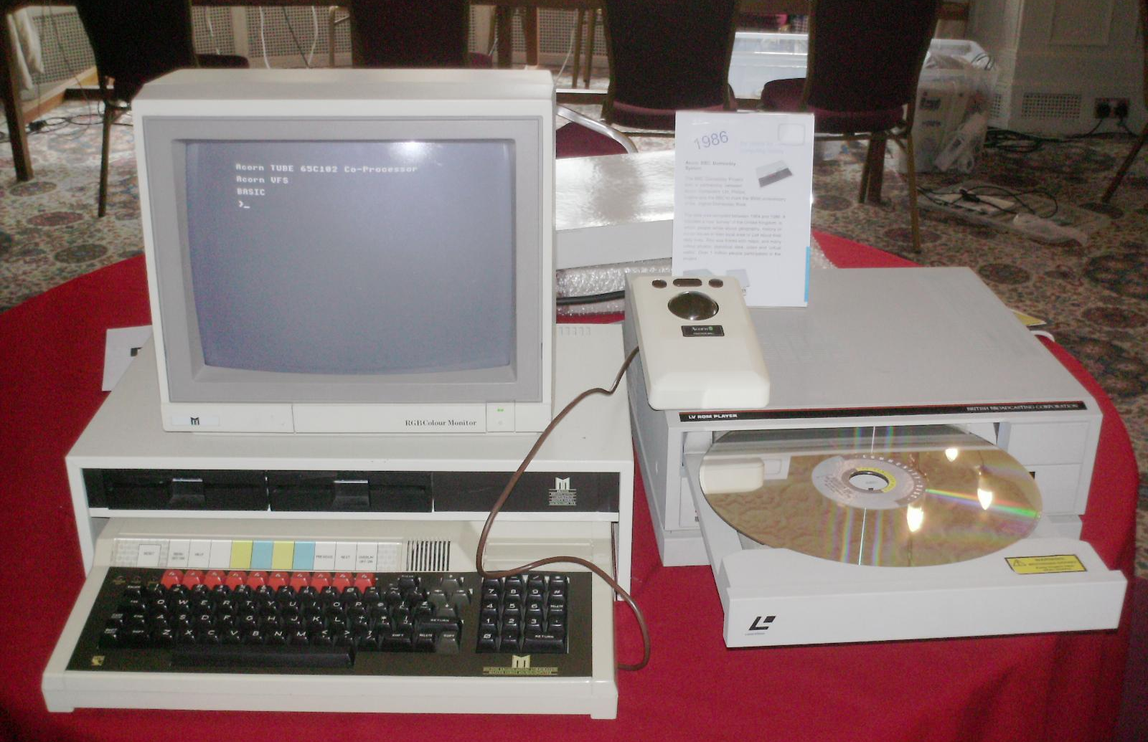
(Photo: A Domesday system at the Vintage Computer Festival 2010, Bletchley, UK. Photo by Regregex, Wikipedia.)
Notes:
Unfortunately, as the machines became obsolete, the laser discs and the data on them became unreadable. Until, roughly, 2011. After efforts by academics and technologists around the world, the BBC’s own technologists, George Auckland and his Innovations Team, completed the extraction of the laser disc. The BBC Domesday Book is now available to the world at large online.
<number>

Slide 66
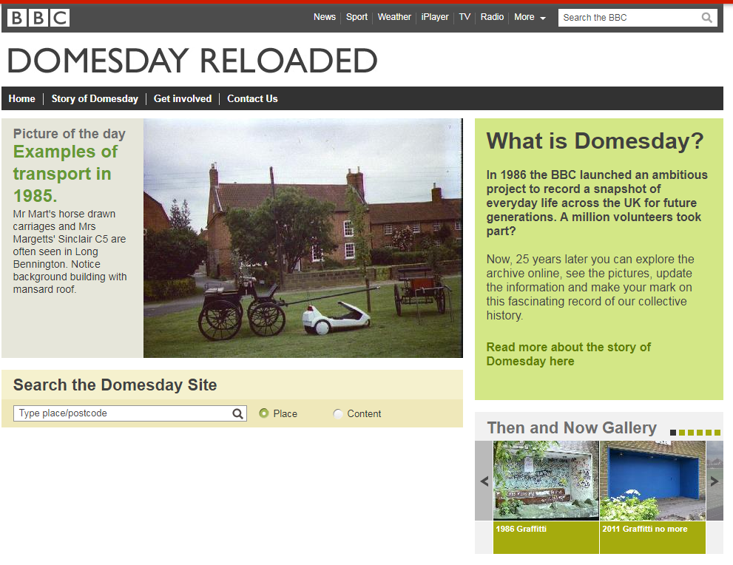

Slide 67
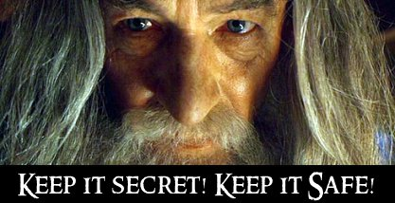
Data Loss and Digital Archives: Storage, Loss, Preservation

Slide 68
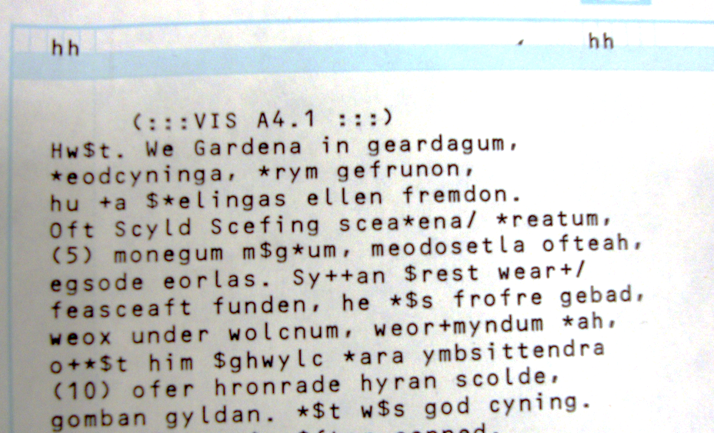
Dictionary of Old English Corpus: 1980s
Beowulf on Scantron (photo by A. Bolintineanu).
Notes:
What can born-digital projects do to prevent losing data to obsolescence? Let’s take a look at another project: U of T’s very own Dictionary of Old English. It lives on the fourteenth floor of Robarts. The DOE studies the earliest form of the English language, from 600 to 1150. Founded in 1970 at the University of Toronto, the Dictionary and its Old English corpus predate the Internet by more than a decade.
In the early seventies, the Dictionary of Old English Project created an electronic corpus (a body of texts) that included at least one version of every known Old English text—typed on a typewriter onto Scantron sheets, because time on the mainframe computer was very expensive (Ashley Crandell Amos, "Computers and Lexicography: The Dictionary of Old English," Editing, Publishing, and Computer Technology, AMS Press, Inc., 1988). These Scantron sheets were scanned, and so the text was digitized. The piece you see above is from the Old English poem Beowulf:
HWÆT, WE GAR-DEna in geardagum, þeodcyninga þrym gefrunon, hu ða æþelingas ellen fremedon!
(Listen, we have heard of the Spear-danes in days of old, the kings of the people and their glory, how the princes performed deeds of courage.)
<number>

Slide 69

Dictionary of Old English Corpus: 2016
Notes:
And here is the DOE Corpus in 2016, accessible online.
<number>

Slide 70
Data Storage
Risky
Safer
Own machine: YIKES
Dropbox or Google Drive: better, but not perfect
Multiple backups off-site
GitHub (version control)
Institutional repository (i.e. the library) with technical safeguards against data degradation
LOCKSS: distributed network of institutional repositories
Dark archives: secret, inaccessible archives (disaster recovery)
Notes:
Storing the data on your own machine is very risky. If you put it in Dropbox or Google Drive, that’s better, but not perfect: what if you or a team member deletes the data by accident? Even better if you have multiple off-site backups: so if e.g. Dropbox has a security failure and your own computer is compromised, you can still get your data from the hard-drive at your parents’. Even better: GitHub (which is a platform that tracks versions of your data, where you have the history of your data and can go back to earlier versions).
If you’re a research institution, you have some other, even safer options.
Your institutional repository is maintained by the library: it’s a place to park your data that has sophisticated technical safeguards against data degradation.
If one institutional repository is nice, more are even better. LOCKSS is an open-source preservation system that sustains a distributed network of institutional repositories. It’s like storing your backup hard-drive at your parents’ and having them store their hard-drive at your house. In other words, everyone protects everyone else’s data. LOCKSS stands for “lots of copies keep stuff safe.” And for additional protection, there are dark archives, for disaster recovery. These keep data secret and inaccessible until a trigger event such as a natural disaster or another kind of catastrophic data loss.
<number>

Slide 71
Hardware and Software Platforms
Risky
Safer
Dedicated, unique software platforms made by commercial providers to fit your data beautifully.
Open-source, community-supported software
Notes:
How long do hardware and software platforms live? What’s their life expectancy?
<number>

Slide 72
Preservation Approaches
Migration
Emulation
Moving your data from an obsolete, less stable platform and format into a newer, more stable platform and format.
Great for simpler digital objects (text, images)
Example: DOE data.
In a new, stable software platform, recreating the—now obsolete—original environment of a digital object
Good for complicated digital objects (software)
Example: old arcade video games.
Notes:
Suppose your data is in an obsolete, unstable platform. What can you do?
<number>

Slide 73

The Internet Archive

Slide 74


The Internet Archive: Public Engagement

Slide 75
Risk Mitigation
LOCKSS
Community-building

Slide 76

Disasters
Library of Celsus, Ephesus, Anatolia, now part of Selçuk, Turkey – destroyed by earthquake and/or fire and/or Goth invasion in 3rd century AD.
Photo: Benh LIEU SONG - Own work, CC BY-SA 3.0, https://commons.wikimedia.org/w/index.php?curid=15578063

Slide 77

Canadian Ice Core Archive:
Freezer fails, temperature rises to about 100 degrees F, ice core samples from Canadian Arctic “which contained 22,000 years’ worth of atmospheric information, were entirely or partially destroyed” (Martin Sharp, cited by Tatiana Schlossberg, “An Ice Scientist’s Worst Nightmare,” New York Times, 11 April 2017)

Slide 78

Risk Mitigation
“collection evacuation risks, prompted by wildfires, floods, and hurricanes
“long-term relocation decisions due to sea-level rise and coastal erosion, or if a weather event is so devastating, rebuilding is inadvisable or impossible
“increasing infrastructure and preservation costs when current HVAC systems can’t keep up with future increases in temperature and humidity” (Eira Tansey, “When the Unbearable Becomes Inevitable: Archives and Climate Change,” 2017, http://eiratansey.com/2017/05/16/fierce-urgencies-2017/)
LOCKSS, dark archives, community building

Slide 79

Marginalized Communities: Archival Absence & Misrepresentation

Slide 80




Marginalized Communities: Archival Absence & Misrepresentation

Slide 81

Notes:
Think about the residential school system in Canada, under which about 150,000 First Nation, Inuit and Métis children were removed from their communities, forced to attend residential schools, not allowed to speak their first language, not allowed to practice native traditions. Many were starved, beaten, sexually abused. Two days ago, Ontario Premier Kathleen Wynne officially apologized to First Nations, Metis, and Inuit communities for the abuses of the residential school system. Part of the Truth and Reconciliation Commission’s work has been to uncover this history. It is not recovery. It is not undoing of cultural genocide. But, and I quote the National Centre for Truth and Reconciliation, “A shared vision held by those affected by Indian residential schools was to create a place of learning and dialogue where the truths of their experiences were honoured and kept safe for future generations. They wanted their families, communities and all of Canada to learn from these hard lessons so they would not be repeated.” The Governing Circle of the archive must “ensure Indigenous control over the materials, ensure Indigenous control over the materials; provide guidance on policies, activities, ceremonies and protocols; and provide guidance on methods and sources for expanding the Centre’s holdings and resources.” The archive does not turn back time. But it safeguards the past and, in so doing, opens up possible futures.
<number>

Slide 82

MUKURTU
“Mukurtu (MOOK-oo-too) is a grassroots project aiming to empower communities to manage, share, narrate, and exchange their digital heritage in culturally relevant and ethically-minded ways.”

Slide 83
MUKURTU
“In 2007, Warumungu community members collaborated with Kim Christen and Craig Dietrich to produce the Mukurtu Wumpurrarni-kari Archive.
Mukurtu is a Warumungu word meaning ‘dilly bag’ or a safe keeping place for sacred materials. Warumungu elder, Michael Jampin Jones chose Mukurtu as the name for the community archive to remind users that the archive, too, is a safe keeping place where Warumungu people can share stories, knowledge, and cultural materials properly using their own protocols.
Growing from this community need, Mukurtu CMS is now an open source platform flexible enough to meet the needs of diverse communities who want to manage and share their digital cultural heritage in their own way, on their own terms.”

Slide 84


Slide 85
Death in the Archives: Bits against Ruins
Communities of practice, ethics of care

Slide 86
Moððe word fræt. Me þæt þuhte wrætlicu wyrd, þa ic þæt wundor gefrægn, þæt se wyrm forswealg wera gied sumes, þeof in þystro, þrymfæstne cwide ond þæs strangan staþol. Stælgiest ne wæs wihte þy gleawra, þe he þam wordum swealg.
A moth ate words. That seemed to me a marvellous fate, when I heard about that wonder, that the worm swallowed up a certain man’s song, the thief in darkness, a glory-fast speech and its strong foundation. The stealing guest was not at all the wiser, for those words he swallowed.
Notes:
I want to begin with a riddle. It’s from the Old English Exeter Book, a tenth-century manuscript that contains Old English poetry and prose—and includes a collection of riddle poems, like this one. The most frequent solution is Moth or Bookworm: a creature that devours books and so swallows up human knowledge and its “strong foundation” without understanding.
<number>

Slide 87
Archive: a collection of records
Metadata: structured data describing data. Think Author, Title, Date in your online library catalogue.
Open-source: Source code of a program is publicly available, and developers may study, modify, and redistribute the code.
Migration: taking data from an obsolete platform or standard into a new, more stable platform and standard
Emulation: accessing data on a new, more stable platform by building around it an environment like that in which it was originally created
LOCKSS: Lots of Copies Keep Stuff Safe
Dark archives: secret, inaccessible archives (disaster recovery)

